Slide 1

计算物理模拟实验
授课人：龚新高 褚维斌
Email: xggong@fudan.edu.cn wbchu@fudan.edu.cn
办公室： 江湾校区交叉一号楼A4007
助教：武思怡
Email: 23210190041@m.fudan.edu.cn
课程微信群

Slide 2
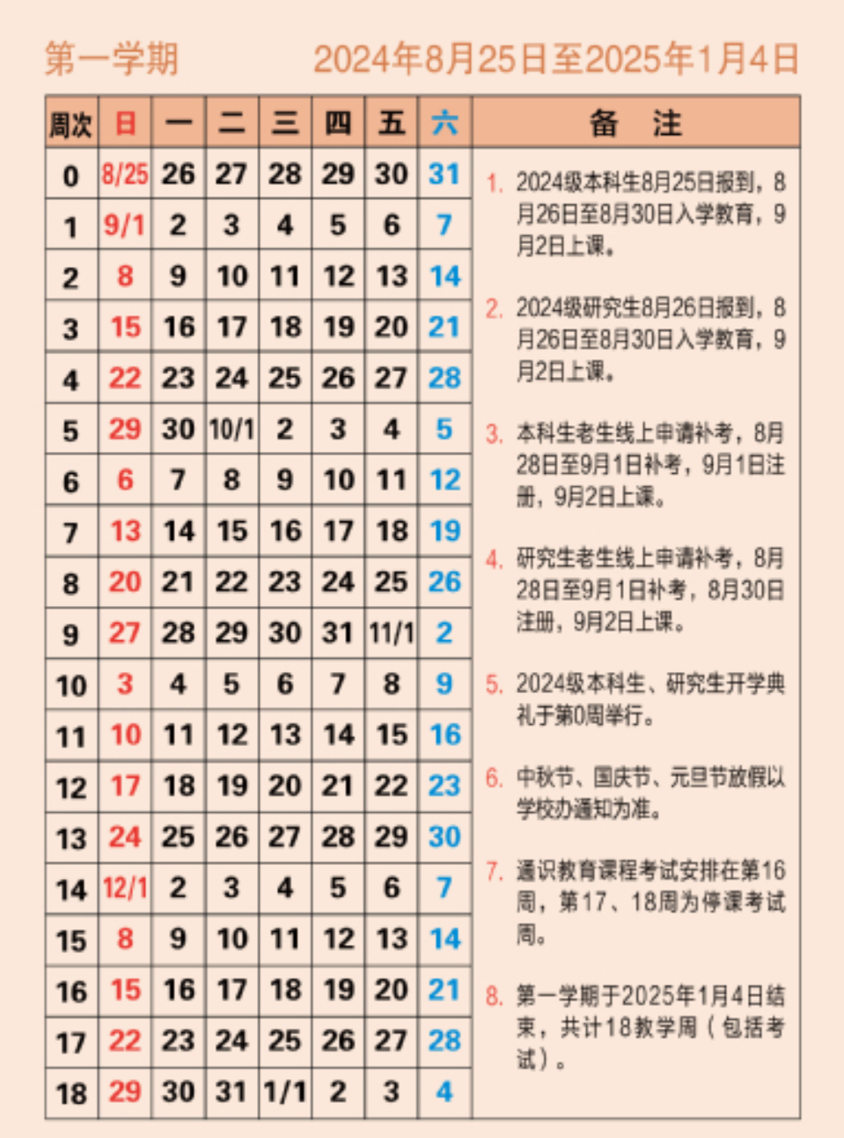
课程安排
时间：周六上午9点
地点：江湾校区交叉一号楼A5005
Project 1 理论课
Project 1 进展总结
Project 1 汇报
Project 2 理论课
Project 2 进展总结
Project 2 汇报
其余时间每周六为答疑时间

Slide 3
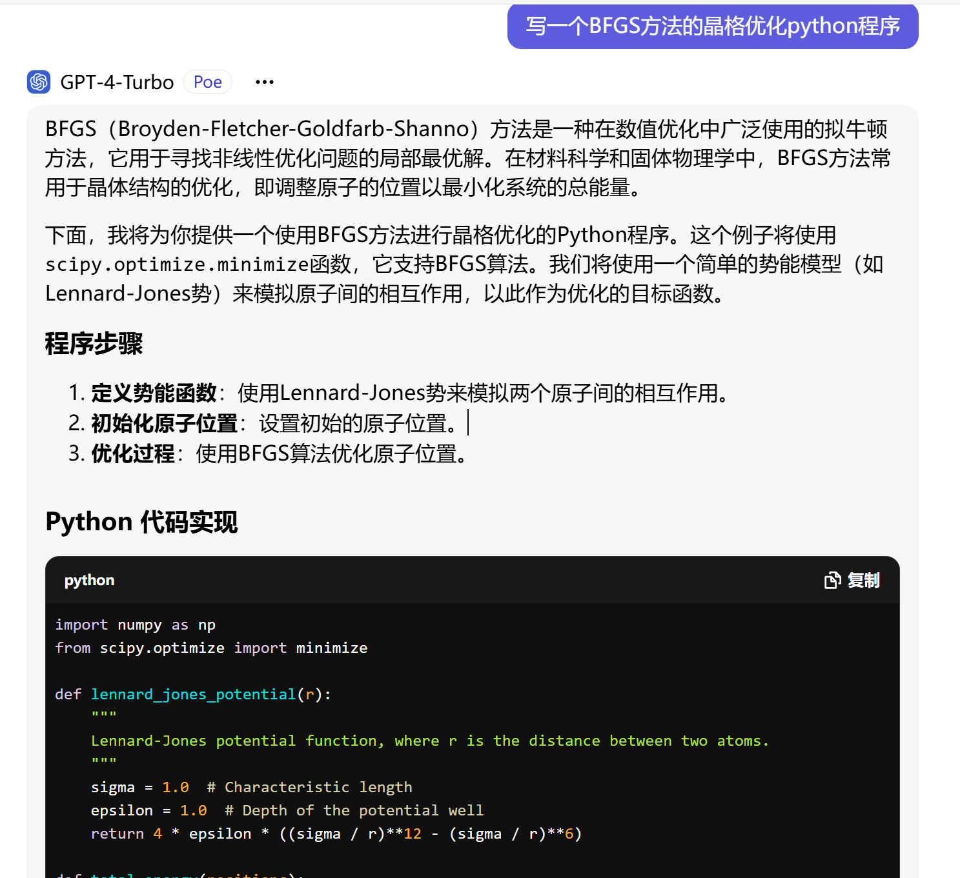
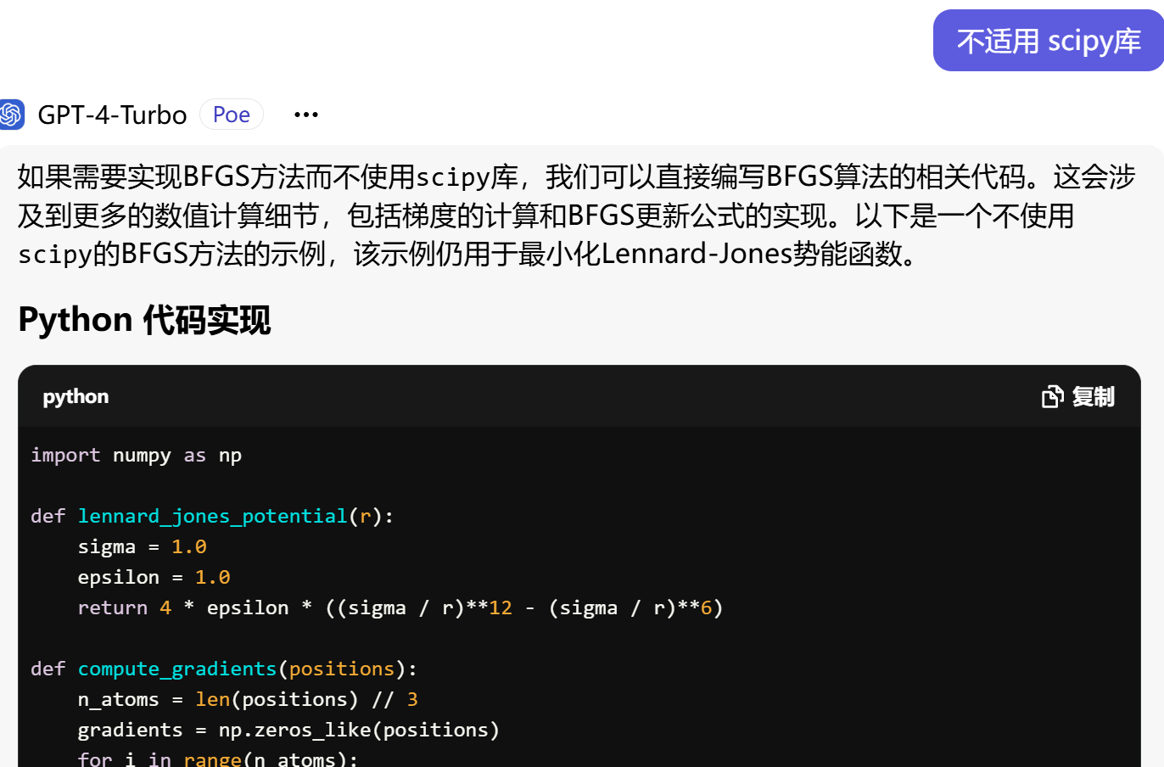
课程考核
课题汇报 (50%)
程序 +实验报告 (45% ) 截止日期： 每次课题汇报后一周
课程反馈 （5%）
旨在借助计算模拟的方法去加深对物理学的重要知识点的理解，对编程技巧不做考核，鼓励使用AI，但注意AI可能会误导！

Slide 4
晶体弹性模拟计算实验
实验目的
1. 了解固体力学性质和原子键合关系
2. 掌握弹性常数等力学量的计算方式
3. 理解弹性波在晶体中的传播
4. 认识温度对力学性能的影响
实验内容
基于原子间相互作用势编写程序计算模拟金属铝和绝缘体金刚石的零温和有限温下的力学性质。并思考分析以下问题：
思考不同化学键对弹性常数以及物理性质的影响，分析计算误差来源与如何降低误差。探索不同晶系的独立矩阵元是否有不同。
基于弹性常数计算两种体系的各种力学量和固体性质，模拟不同晶体中弹性波在[100]、[110]、[111]方向的传播，观察横波和纵波的区别。

Slide 5
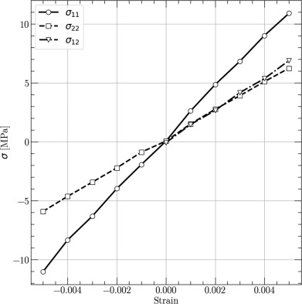
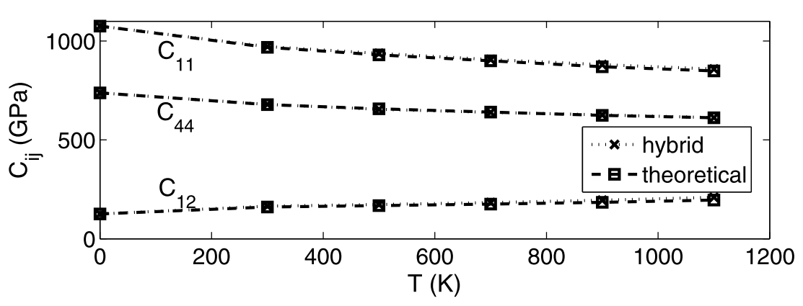
模拟不同的Strain大小对应的Stress， 得到Strain-Stress relation，思考在多大的范围内胡克定律成立？
模拟金刚石不同温度下的弹性常数，观察不同弹性常数随温度变化的趋势。

Slide 6
Elasticity
Important because most engineering design is done in the elastic region. (Remember, plastic deformation generally constitutes failure.)
Macroscopically, most polycrystalline materials are elastically isotropic.
Microscopically, elastic behavior is inherently anisotropic for individual grains.
Polycrystalline materials can be anisotropic if they exhibit strong crystallographic textures.

Slide 7
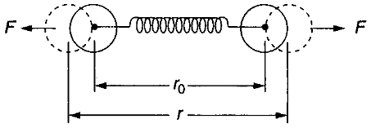
Elasticity
U
Repulsion
Derived from atomic bonding forces originating from long range attractive forces which draw atoms together until short range repulsive forces become large enough to balance them out.
r_{o}
r
Attraction
F is maximum at point of inflection in U/r curve
As such, elastic properties are an aggregate effect of individual deformations of interatomic bonds.
F
F = -dU/dr
r
o
r

Slide 8
Bulk Elastic Behavior
Applied force is transmitted by the network of bonds constituting the material.
Thus, elastic behavior depends quantitatively on the magnitude of the interatomic forces.
Elastic properties do not depend on microstructure of the material.

Slide 9
Forces Between Atoms
Bonds form when atoms either share (e.g., covalent and metallic bonds) or transfer (e.g., ionic bonds) electrons between atoms.
This occurs to achieve a minimum in potential energy for the system corresponding to a stable electron configuration.
This has been modeled for ionic systems as follows:

Slide 10
Ionic Bond
Electron transfer from one atom to another occurs due to electrostatic interaction between oppositely charged ions (e.g., Na⁺ and Cl⁻ in NaCl).
r
+
-
Force of attraction between ions is F_{attract}
_{q}2
^{F}attract
=
4πε r
2
o
Work is done to draw ions together. It is given by:
q = charge of ion
ε = permittivity of free space
o
r
−q² − A
r = ionic separation distance
∫
^{U}attract
= F
dr =
=
attract
4πε r r
m
∞
o

Slide 11
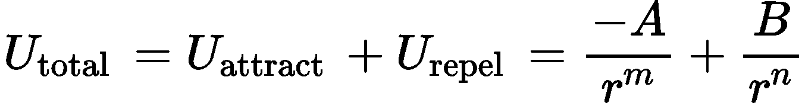
Each atom maintains an electron cloud surrounding it. The outer surfaces of each atom are both negatively charged.
Thus, at close distances, the electron clouds overlap and repel. The repulsive force can be written as:
₌ B
U
_{r}n
repel
The total energy of the system is thus the sum of the attractive and repulsive components. It can be expressed in general as:
This is the well known Lennard-Jones potential. You might recall this from your chemistry or physics courses.

Slide 12
U
Repulsion
The minimum energy point corresponds to the equilibrium separation (i.e., the equilibrium bond length, r_{o}).
r_{o}
r
The force between atoms is simply the derivative (i.e., the slope) of the energy versus distance plot.
_{F =} ^{−dU}total
Attraction
dr
F
The bond stiffness is the derivative of the force versus distance plot.
r_{o}
r
dF d ²U
S =
₌ total
dr dr ²

Slide 13
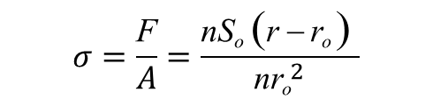
At the equilibrium bond length, r_{o}, the variation of F with r is essentially linear, which means that the stiffness is essentially constant at small distances from r_{o}.
₌ dF
S
o
dr
r_{o}
Using this expression, the force to “stretch” n bonds in a solid is:
r
F = n∫ S_{o}dr = nS_{o} (r − r_{o} )
r_{o}
where n is the number of bonds.
σ
The applied stress is:
r
$$σ=\frac{\text{F}}{A}=\frac{\text{nS}\text{o} \text{(}\text{r} \text{−} \text{r}\text{o} \text{)} }{\text{n}{\text{r}\text{o}}^{2}}$$
o
r
r_{o}
o

Slide 14
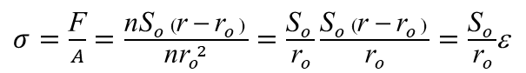
The derived expression shows that the modulus is dependent upon bonding.
The strain can be expressed as:
_{ε =} r − r_{o}
r_{o}
Thus, stress becomes:
Modulus, and other elastic properties, are
structure insensitive.
$σ=\frac{\text{F}}{A}=\frac{\text{nS}\text{o} \text{(}\text{r} \text{−} \text{r}\text{o} \text{)} }{\text{n}{\text{r}\text{o}}^{2}}=\frac{\text{S}\text{o} }{\text{r}\text{o}}\frac{\text{S}\text{o} \text{(}\text{r} \text{−} \text{r}\text{o} \text{)} }{\text{r}\text{o}}=\frac{\text{S}\text{o} }{\text{r}\text{o}}$ε
From Hooke’s law:
σ = Eε
The directionality of elastic properties does depend upon atomic arrangement (crystallography) in single crystals. They tend to average out in polycrystals.
Thus,
S 1 d ²U
_{E =} o
r_{o} r_{o} dr
=
2
r =r
o

Slide 15
Bonding Type | Material, Substance | Bonding Energy |  | Melting Temperature °C
 |  | kJ/mol | eV/Atom, Ion, Molecule
Ionic | NaCl | 640 | 3.3 | 801
 | MgO | 1000 | 5.2 | 2800
Covalent | Si | 450 | 4.7 | 1410
 | C (diamond) | 713 | 7.4 | >3550
Metallic | Hg | 68 | 0.7 | -39
 | Al | 324 | 3.4 | 660
 | Fe | 406 | 4.2 | 1538
 | W | 849 | 8.8 | 3410
van der Waals | Ar | 7.7 | 0.08 | -189
 | Cl₂ | 31 | 0.32 | -101
Hydrogen | NH₃ | 35 | 0.36 | -78
 | H₂O | 51 | 0.52 | 0
[From W.D. Callister, Jr, Materials Science and Engineering: An Introduction, 7th Ed., (Wiley, New York, 2007) p.28]

Slide 16
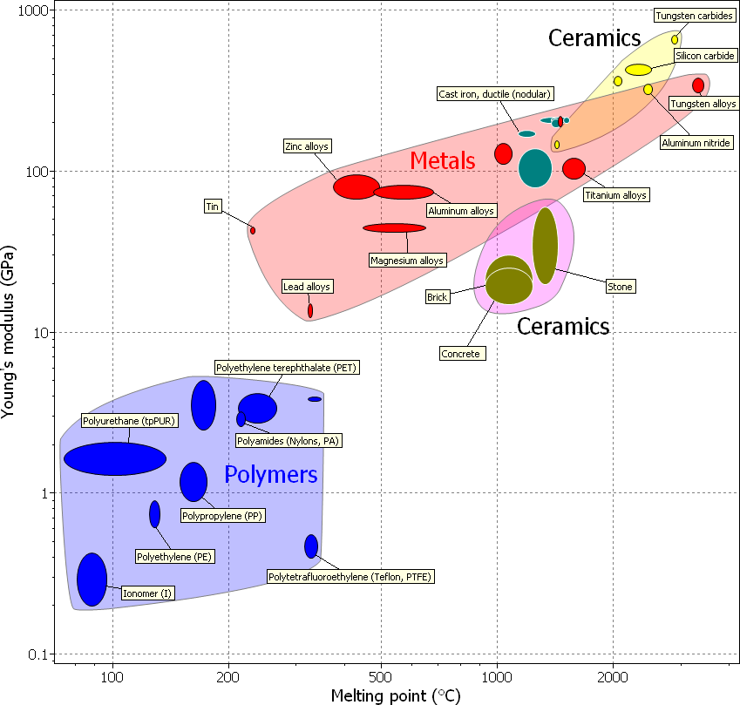

Slide 17
Metallic bonding
Covalent or Ionic bonding
Steel Copper Aluminum Zinc Lead Metals | PEEK PP PTFE Polymers | WC Alumina Glass Ceramics | CFRP GFRP Fibreboard Composites
Young’s modulus, GPa
Courtesy of Granta Design
A bar chart illustrating Young’s moduli for some common examples of the primary
classes of materials (i.e., metals, ceramics, polymers and composites). tend to exhibit the highest elastic moduli and polymers the lowest. moduli of composites are between those of their constituents.
Ceramics
The elastic

Slide 18
stress is related to strain for an isotropic solid
Hooke’s Law
– Isotropic Solids (properties are the same in all directions)
Unload
Stress
Load
Slope = E (Modulus of elasticity)
σ = ε E or ε = ¹ σ
E
0
Anisotropic solids (properties are directional)
Need different definition
Let’s consider both cases
0
Strain
Stress-strain plot for a linearly elastic material

Slide 19
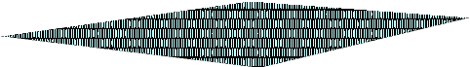
First consider the Poisson effect
z
x
y
unloaded
F
loaded
ν (z, x) = − ^{ε x} and ν (z, y) = − ^{ε y}
ε _{z} ε _{z}
A tensile stress along the z axis causes the material to stretch along the z axis and to contract along the x and y axes.
lateral strain
Poisson's Ratio, ν = −
longitudinal strain

Slide 20
Material Class | Material | ν
Metallic solid | Ag | 0.38
(crystalline) | Al | 0.34
 | Au | 0.42
 | Cu | 0.34
 | α-Fe | 0.29
 | Ir | 0.26
 | Ni | 0.31
 | W | 0.29
Covalent solid | Ge | 0.28
(crystalline) | Si | 0.27
 | Al₂O₃ | 0.23
 | TiC | 0.19
Covalent Ionic Solid | MgO | 0.19
Covalent Glass | Silica glass | 0.20
Network Polymer | Bakelite | 0.20
 | Ebonite (hard rubber) | 0.39
Elastomer | Natural rubber | 0.49
Chain Polymer | Polystyrene | 0.33
 | Polyethylene | 0.40
Van der Waal’s Solid | Argon (at 0 K) | 0.25
Room- Temperature Poisson’s Ratio for Selected Solids

Slide 21
A
B
_{σ} C
σ
yy
yy
^{σ} xx
^{σ} xx
^{σ} xx
^{σ} xx
^{σ} yy
^{σ} yy
The strains resulting from this stress state must be the sum of the strains associated with loading along each individual axis.
σ
B: ε
B
xx
, ε νε = −ν ^{σ xx}
=
B B
yy
xx
= −
E
xx
E
σ
C: ε
yy
C
yy
= , ε νε = −ν ^{σ yy}
C
xx
= −
C
E
yy
E
A = B+C : ε = ε
+ ε
₌ ^{σ} xx
_{−ν} ^{σ} yy
There’s a similar expression for ε_{yy}
B
xx
C
xx
xx
E
E

Slide 22
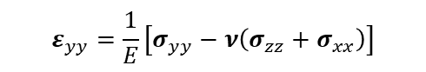
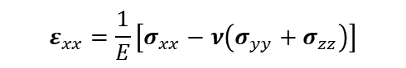
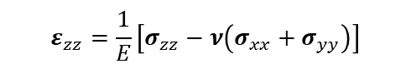
Elastic Stress-Strain Relations
Strain in the x-direction
Strain in the y-direction
Strain in the z-direction
Stress
σ
₌ ^{σ} xx
νσ _{xx}
νσ _{xx}
ε
ε _{yy} =− _{E}
ε _{zz} =− _{E}
xx
xx
E
σ
νσ _{yy}
^{σ} yy
νσ _{yy}
yy
ε _{xx} =− _{E}
ε _{yy} =
ε _{zz} =− _{E}
E
σ
νσ _{zz}
νσ _{zz}
^{σ} zz
ε _{xx} =− _{E}
ε _{yy} =− _{E}
ε _{zz} = _{E}
zz
$$ε_{xx}=\frac{1}{E}\left[σ_{xx}−ν\left(σ_{yy}+σ_{zz}\right)\right]$$
Variation in elastic strain for an isotropic solid because of the Poisson effect
$$ε_{yy}=\frac{1}{E}\left[σ_{yy}−ν\left(σ_{zz}+σ_{xx}\right)\right]$$
$$ε_{zz}=\frac{1}{E}\left[σ_{zz}−ν\left(σ_{xx}+σ_{yy}\right)\right]$$
τ _{xy} = Gγ _{xy} ; τ _{yz} = Gγ _{yz} ; τ _{xz} = Gγ _{xz}

Slide 23
Other Elastic Stress-Strain Relations for Isotropic Solids
Bulk Modulus (K), also known as the volumetric elastic modulus:
_{K =} hydrostatic pressure ₌ σ _{m =} − p ₌ 1 volume change produced Δ Δ B
where:
- p = hydrostatic pressure,
σ
₌ ^{σ} xx ^{+ σ} yy ^{+ σ} zz
m
3
Δ = dilatation (i.e., volume change) = ε _{xx}
B = compressibility.
+ ε _{zz} ,
^{+ ε} yy

Slide 24
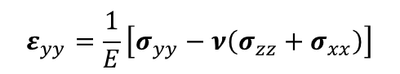
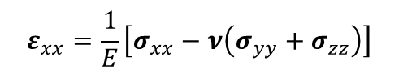
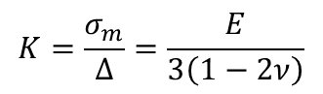
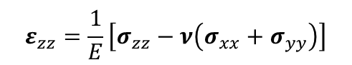
Other Elastic Stress-Strain Relations for Isotropic Solids
Now we can relate the elastic constants.
$$ε_{xx}=\frac{1}{E}\left[σ_{xx}−ν\left(σ_{yy}+σ_{zz}\right)\right]$$
$$ε_{yy}=\frac{1}{E}\left[σ_{yy}−ν\left(σ_{zz}+σ_{xx}\right)\right]$$
$$ε_{zz}=\frac{1}{E}\left[σ_{zz}−ν\left(σ_{xx}+σ_{yy}\right)\right]$$
Summation yields:
$$ε_{xx}+ε_{yy}+ε_{zz}=\frac{1−2ν}{E}\left(σ_{xx}+σ_{yy}+σ_{zz}\right)=\frac{1−2ν}{E}3σ_{m}=Δ$$
∴
$$K=\frac{σ_{m}}{Δ}=\frac{E}{3\left(1−2ν\right)}$$

Slide 25
Other Elastic Stress-Strain Relations for Isotropic Solids
In terms Elastic constants | E, ν | E, G | K, ν | E, G | λ, μ
E [elastic] | = E | = E | = 3(1 − 2ν ) K | ₌ 9K 1 + 3K / G | μ (3 + 2μ / λ ) ⁼ 2 (1 + μ / λ )
ν | = ν | = −1 + ^{E} 2G | = ν | ₌ 1 − 2G / 3K 2 + 2G /3K | 1 ⁼ 2 (1 + μ / λ )
G [shear] | E ⁼ 2 (1 +ν ) | = G | 3(1 − 2ν ) K ⁼ 2 (1 +ν ) | = G | = μ
K [bulk] | E ⁼ 3(1 − 2ν ) | ₌ E 9 − 3E / G | = K | = K | = λ + ^{2μ} 3
λ | Eν ⁼ (1 +ν )(1 − 2ν ) | ₌ E (1− 2G / E ) 3 − E / G | ₌ 3Kν 1 +ν | = K − ^{2G} 3 | = λ
μ | E ⁼ 2 (1 +ν ) | = G | 3(1 − 2ν ) K ⁼ 2 (1 +ν ) | = G | = μ
λ, μ = Lame constants

Slide 26
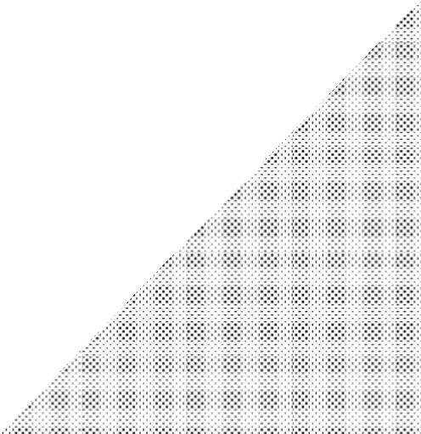
Elastic Strain Energy
Energy stored in a body due to deformation.
Work to deform a body elastically is stored as elastic strain energy. It is recovered when the applied forces are released.
Strain energy is proportional to the area under the load- deformation (stress-strain) curve.
We will elaborate on this concept on the next
few pages.
Load F
U = ¹ Fδ
2
Deformation δ

Slide 27
Elastic Strain Energy
The first law of thermodynamics states:
dU = δ Q + δW = TdS − PdV
where,
dU = internal energy
δQ = heat
δW = mechanical work done
During elastic deformation, the amount of heat generated is negligible.
Thus the work done on the body is converted into internal energy and is fully recovered upon unloading.

Slide 28
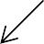
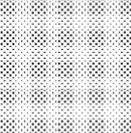
Elastic Strain Energy
Consider an elemental cube that is subjected to only an elastic tensile stress along the x-axis. The elastic strain energy, U, is:
U = ¹ (load)(deformation)
2
z
y
1 1
1
dU = Fdu = (σ _{xx} A)(ε _{xx} dx) = (σ _{xx}ε _{xx} )( Adx)
x
2 2 2
= total elastic energy absorbed by the material element.
A
^{σ} xx
Since Adx is the volume, the elastic strain energy per unit volume (i.e., the strain energy density) is:
F
σ _{xx} = _{A}
ε
₌ du
dU 1
= (σ ε ).
xx
dx
U =
o
Adx 2
xx xx

Slide 29
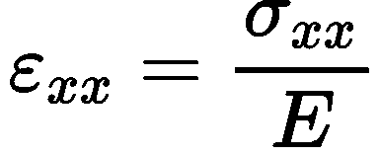
Elastic Strain Energy
From Hooke's law,
z
Therefore:
y
1 σ 1
2 E 2
2
= ε E [in tension]
x
U_{o} =
xx
2
xx
1
1
τ
2
1
U = (τ γ ) =
xy
= γ G [in pure shear]
A
2
o xy xy
xy
2 2 G 2
^{σ} xx
σ
₌ F
In three dimensions, the general expression for elastic strain energy is:
xx
A
ε
₌ du
1
2
xx
dx
U_{o} =
(^{σ} xx^{ε} xx ^{+ σ} yy^{ε} yy ^{+ σ} zz^{ε} zz ^{+τ} xy^{γ} xy ^{+τ} xz^{γ} xz
+τ _{yz}γ _{yz} ).

Slide 30
Elastic Strain Energy
In tensor notation, these general expressions become:
1 1
σ
2
ij
1
U = σ ε =
= ε E.
2
o ij ij
ij
2 2 E 2
If we substite into these expressions, the variation in elastic strain for an isotropic solid, accounting for the Poisson effect, we get:
1
₋ ν
E
1
( )
( )
(
)
U =
σ
2
xx
+ σ ² + σ
2
zz
σ σ + σ σ + σ σ +
τ
2
xy
+ τ ² + τ ²
xz yz
o
2E
yy
xx yy
yy zz
xx zz
2G
[for a 3D isotropic solid]
Expressed in terms of strains and elastic constants:
( )
1
(
)
U = ¹ λΔ² + G ε
2
xx
+ ε
2
yy
+ ε
2
zz
+ G γ
2
xy
+ γ + γ
2
xz
2
yz
o
2
2

Slide 31
Elastic Strain Energy
$$U_{o}=\frac{1}{2}\left(σ_{xx}ε_{xx}+σ_{yy}ε_{yy}+σ_{zz}ε_{zz}+τ_{xy}γ_{xy}+τ_{xz}γ_{xz}+τ_{yz}γ_{yz}\right)$$
The derivative of U_{o} with respect to any strain component yields the corresponding stress component, or:
∂U_{o}
= λΔ + 2Gε = σ
∂ε
ij
ij
ij
Similarly, the derivative of U_{o} with respect to any stress component yields the corresponding strain or:
∂U_{o}
= ε
∂σ
ij
ij
You can use these terms to calculate stresses and strains in elasticty. Techniques for doing this include Castigliano's theorem, the theorem of least work, and the principal of virtual work.

Slide 32

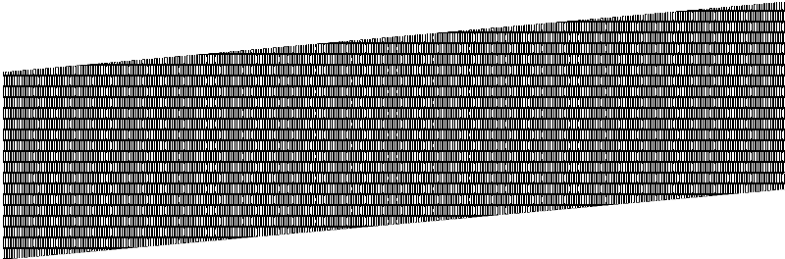



Anisotropy and Single Crystals
Forces between atoms are directional.
(110)_{BCC}
They act along the “lines” connecting the atoms together.

Slide 33
Relations between stress and strain for anisotropic crystals
Since force varies with direction, elastic constants will also vary.
In general, we need to relate every stress component to every strain component.
Thus we must define two new elastic constants:
C ≡ stiffness
S ≡ compliance
We also re-write Hooke’s law as:
^{σ} ij ^{= C}ijkl^{ε}kl ^{or ε}ij ^{= S}ijkl^{σ} kl

Slide 34
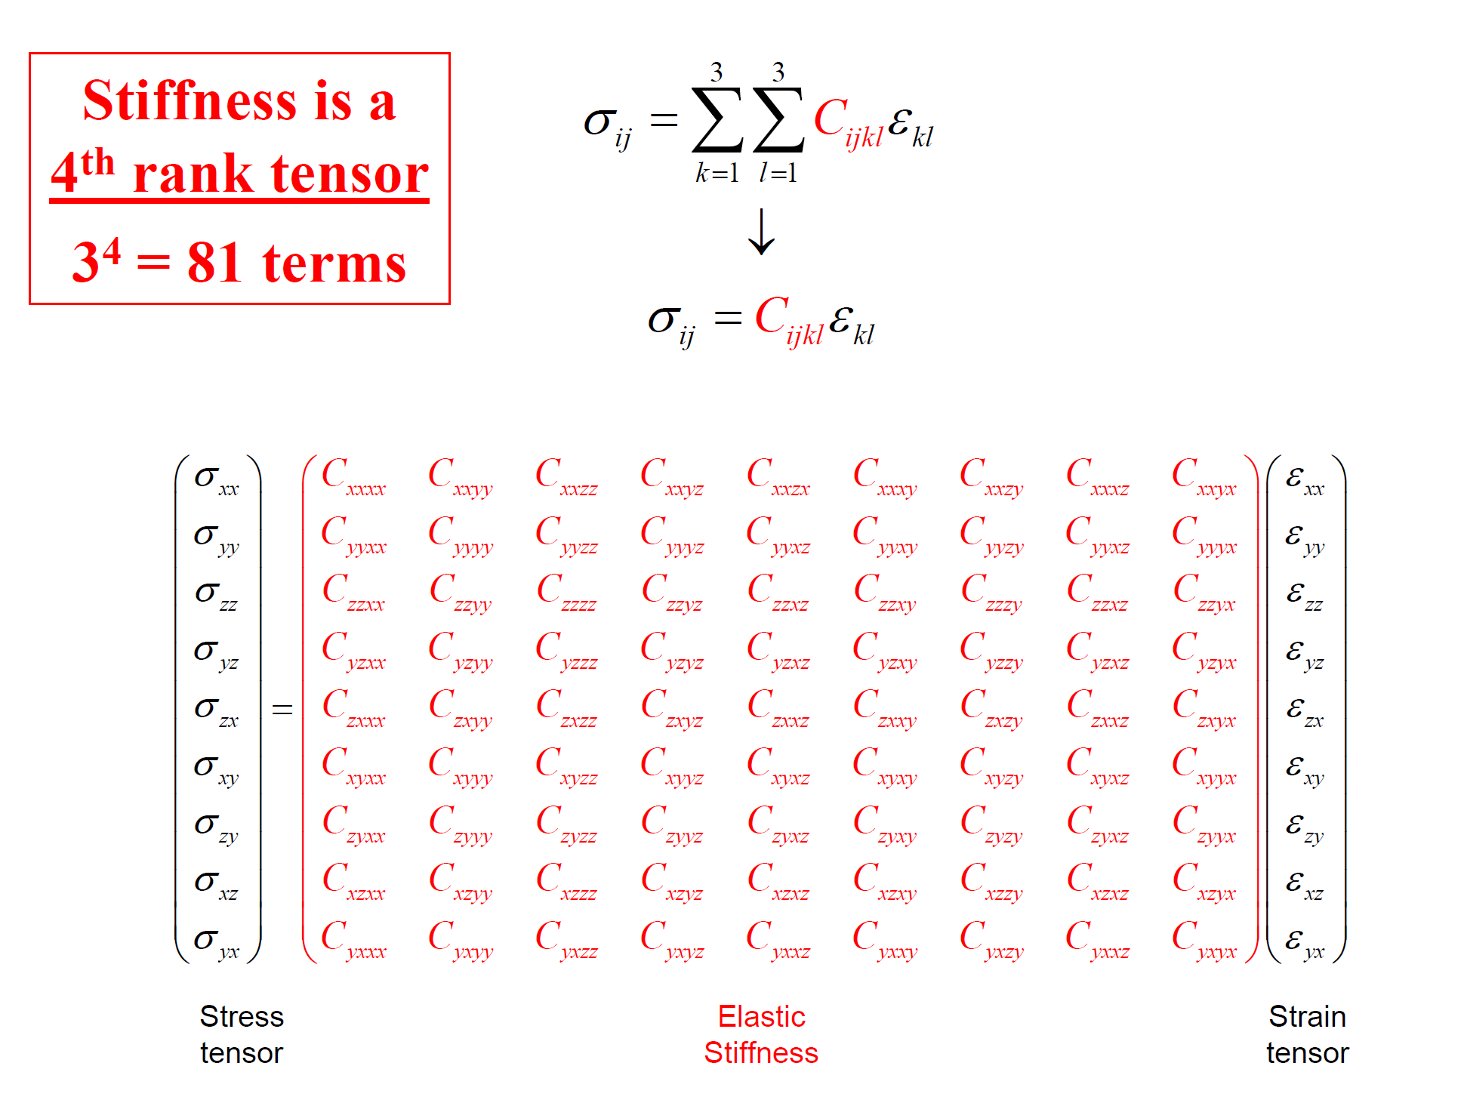

Slide 35
Allow us to reduce the number of constants from 81 to 36
EQUILIBRIUM CONSIDERATIONS
^{σ} ij ^{= σ} ji ^{C}ijkl ^{= C} jikl ^{C}ijkl ^{= C} jikl
^{ε}kl ^{C}ijkl ^{C}ijkl
= ε_{lk}
^{= C} jikl
^{= C}ijlk
⎛σ _{xx} ⎞
⎛ ^{C}xxxx
^{C}xxyy
^{C}xxzz
^{C}xxyz
^{C}xxxz
^{C}xxxy ⎞⎛ ^{ε} xx ⎞
⎜_{σ} ⎟ ⎜ _{C}
C
C
C
C
C
⎟⎜ _{ε} ⎟
⎜
yy ⎟
⎜
yyxx
yyyy
yyzz
yyyz
yyxz
yyxy ⎟⎜ yy ⎟
⎜ σ ⎟
⎜ C
^{C}zzyy
^{C}zzzz
^{C}zzyz
^{C}zzxz
^{C}zzxy ^{⎟⎜ ε} zz ⎟
zz
=
zzxx
⎜_{σ} ⎟
⎜ _{C}
⎟⎜ _{ε} ⎟
⎜
yz ⎟
⎜
C
C
C
C
C
yzxy ⎟⎜ yz ⎟
yzxx
yzyy
yzzz
yzyz
yzxz
⎜ σ _{xz} ⎟
^{⎜ C}xzxx
^{C}xzyy
^{C}xzzz
^{C}xzyz
^{C}xzxz
^{C}xzxy ^{⎟⎜ ε} xz ⎟
⎜_{σ} ⎟ ⎜ _{C}
⎟⎜ _{ε} ⎟
⎝
xy ⎠
⎝
C
C
C
C
C
xyxy ⎠⎝ xy ⎠
xyxx
xyyy
xyzz
xyyz
xyxz

Slide 36
⎛σ _{xx} ⎞
⎛σ _{xz} ⎞
⎛ ^{C}xxxx
^{C}xxyy
^{C}xxzz
^{C}xxyz
^{C}xxxz
^{C}xxxy ⎞⎛ ^{ε} xx ⎞
⎜_{σ} ⎟
⎜ _{C}
C
C
C
C
C
⎟⎜ _{ε} ⎟
⎜
yy ⎟
⎜
yyxx
yyyy
yyzz
yyyz
yyxz
yyxy ⎟⎜ yy ⎟
⎜
σ
zz
⎟ ⎜ C
zzxx
^{C}zzyy
^{C}zzzz
^{C}zzyz
^{C}zzxz
^{C}zzxy ^{⎟⎜ ε} zz ⎟
=
⎟⎜ _{ε} ⎟
⎜_{σ} ⎟ ⎜ _{C}
C
C
C
C
C
⎜
yz ⎟
⎜
yzxx
yzyy
yzzz
yzyz
yzxz
yzxy ⎟⎜ yz ⎟
⎜ σ _{xz} ⎟
^{⎜ C}xzxx
^{C}xzyy
^{C}xzzz
^{C}xzyz
^{C}xzxz
^{C}xzxy ^{⎟⎜ ε} xz ⎟
⎜_{σ} ⎟ ⎜ _{C}
C C
C
C C
⎟⎜ _{ε} ⎟
⎝
xy ⎠
⎝
xyxx
xyyy
xyzz
xyyz
xyxz
xyxy ⎠⎝ xy ⎠
^{σ} ij ^{= C}ijkl^{ε}kl
C_{ijkl} is the STIFNESS matrix
⎛ ε _{xx} ⎞
⎛ ^{S}xxxx
^{S}xxyy
^{S}xxzz
^{S}xxyz
^{S}xxxz
^{S}xxxy ⎞⎛^{σ} xx ⎞
⎜ _{ε} ⎟ ⎜ _{S}
S
S
S
S
S
⎟⎜_{σ} ⎟
⎜
yy ⎟
⎜
yyxx
yyyy
yyzz
yyyz
yyxz
yyxy ⎟⎜ yy ⎟
⎜
ε
⎟ ⎜ S
^{S}zzyy
^{S}zzzz
^{S}zzyz
^{S}zzxz
^{S}zzxy ^{⎟⎜ σ} zz ⎟
zz
=
zzxx
⎟⎜_{σ} ⎟
⎜ _{ε} ⎟ ⎜ _{S}
S
S
S
S
S
⎜
yz ⎟
⎜
yzxx
yzyy
yzzz
yzyz
yzxz
yzxy ⎟⎜ yz ⎟
⎜ ε _{xz} ⎟
^{⎜ S}xzxx
^{S}xzyy
^{S}xzzz
^{S}xzyz
^{S}xzxz
^{S}xzxy ^{⎟⎜ σ} xz ⎟
⎜ _{ε} ⎟ ⎜ _{S}
S S
S
S S
⎟⎜_{σ} ⎟
⎝
xy ⎠
⎝
xyxx xyyy
xyzz
xyyz
xyxz
xyxy ⎠⎝ xy ⎠
^{ε}ij ^{= S}ijkl^{σ} kl
S_{ijkl} is the COMPLIANCE matrix

Slide 37



Matrix/Contracted Notation
We often replace the indices with matrix (contracted) notation for simplicity [Voigt, Lehrbuch der Kristallphysik (Teubner VErlag, Berlin, 1910)].
xx → 11 → 1
yz → 23 → 4
yy → 22 → 2
xz → 13 → 5
zz → 33 → 3
xy → 12 → 6
⎛11 12 13 ⎞ ⎛ 1 6 5 ⎞
⎜ 22 23⎟ ≡ ⎜ 2 4 ⎟
⎜
33⎟
⎜ ₃ ⎟
⎝ ⎠ ⎝ ⎠
Thus, Hooke’s law is often re-written in matrix form as:
σ _{p} = C_{pq}ε_{q} or ε _{p} = S_{pq}σ _{q}
row
column

Slide 38
Additional note about contracted notation
Numbers 1-3 are associated with normal stresses and strains.
3
5
4
4
5
2
6
Numbers 4-6 are associated with shear stresses and strains.
1
6
z
On the next slide I attempt to show you which stresses and strains are related to each elastic constant.
y
x

Slide 39
σ ,ε
^{C}xxyy
σ ,γ
^{C}xxxz
TENSOR
⎛ ^{C}xxxx
^{C}xxzz
^{C}xxyz
^{C}xxxy ⎞
⎜ _{C}
C
C
C
C
C
⎟
⎜
yyxx
yyyy
yyzz
yyyz
yyxz
yyxy ⎟
C
₌ ^{⎜ C}zzxx
^{C}zzyy
^{C}zzzz
^{C}zzyz
^{C}zzxz
^{C}zzxy ⎟
ijkl
⎜ _{C}
C
C
C
C
C
⎟
⎜
yzxx
yzyy
yzzz
yzyz
yzxz
yzxy ⎟
^{⎜ C}xzxx
^{C}xzyy
^{C}xzzz
^{C}xzyz
^{C}xzxz
^{C}xzxy ⎟
⎜ _{C}
C
C
C
C
C
⎟
xyxy ⎠
⎝
xyxx
xyyy
xyzz
xyyz
xyxz
τ ,ε
τ ,γ
σ ,ε σ ,γ
^{C}12 ^{C}13 ^{C}14 ^{C}15 ^{C}16 ⎞
CONTRACTED
⎛ ^{C}11
⎜ _{C}
C C C C C
⎟
⎜
21
22
23
24
25
26 ⎟
C
₌ ^{⎜ C}31 ^{C}32 ^{C}33 ^{C}34 ^{C}35 ^{C}36 ⎟
ijkl
⎜ _{C}
C C C C C
⎟
⎜
41
42
43
44
45
46 ⎟
^{C}52 ^{C}53 ^{C}54 ^{C}55 ^{C}56 ⎟
⎝ 61 62 63 64 65 66 ⎠
τ ,ε τ ,γ
^{⎜ C}51
⎜ _{C}
C C C C C
⎟

Slide 40
Contracted vs. Tensor Notation
Contracted notation is simple and convenient for conducting matrix inversions.
However, for coordinate transformations or invariant determination, it is more useful to use the stiffness and compliances in tensor notation.

Slide 41
Note the change from tensor notation to matrix notation. See Chapter 8 in Nye for details.
⎛ σ₁ ⎞
⎛ ^{C}11 ^{C}12 ^{C}13 ^{C}14 ^{C}15
C₁₆ ⎞⎛ ε₁ ⎞
⎜_{σ} ⎟
⎜ _{C}
C C C C C
⎟⎜ _{ε} ⎟
⎜
2 ⎟
⎜
21
22
23
24
25
26 ⎟⎜ 2 ⎟
⎜σ ₃ ⎟ ₌ ⎜ C₃₁
^{C}32 ^{C}33 ^{C}34 ^{C}35
C₃₆ ⎟⎜ ε₃ ⎟
⎜_{σ} ⎟
⎜ _{C}
C C C C C
⎟⎜ _{ε} ⎟
⎜
4 ⎟
⎜
41
42
43
44
45
46 ⎟⎜ 4 ⎟
⎜σ ₅ ⎟
^{⎜ C}51
^{C}52 ^{C}53 ^{C}54 ^{C}55
62 63 64 65
C₅₆ ⎟⎜ ε₅ ⎟
⎜_{σ} ⎟
⎜ _{C}
C
C C C C
⎟⎜ _{ε} ⎟
⎝
6 ⎠
⎝
61
66 ⎠⎝ 6 ⎠
σ _{p} = C_{pq}ε_{q}
C_{pq} is the STIFNESS matrix
⎛ ε₁ ⎞
⎛ ^{S}11 ^{S}12 ^{S}13 ^{S}14 ^{S}15
S₁₆ ⎞⎛ σ₁ ⎞
⎜ _{ε} ⎟
⎜ _{S}
S S S S S
⎟⎜_{σ} ⎟
⎜
2 ⎟
⎜
21 22 23 24 25 26 ⎟⎜ 2 ⎟
⎜ ε₃ ⎟ ₌ ⎜ S₃₁
^{S}32 ^{S}33 ^{S}34 ^{S}35
S₃₆ ⎟⎜σ ₃ ⎟
⎜ _{ε} ⎟ ⎜ _{S}
S S S S S
⎟⎜_{σ} ⎟
⎜
4 ⎟
⎜
41 42 43 44 45 46 ⎟⎜ 4 ⎟
⎜ ε₅ ⎟
^{⎜ S}51 ^{S}52 ^{S}53 ^{S}54 ^{S}55
S₅₆ ⎟⎜σ ₅ ⎟
⎜ _{ε} ⎟ ⎜ _{S}
S S S S S
⎟⎜_{σ} ⎟
⎝
⎝
6 ⎠ 61 62 63 64 65 66 ⎠⎝ 6 ⎠
ε _{p} = S_{pq}σ _{q}
S_{pq} is the COMPLIANCE matrix

Slide 42
Stiffness and compliance matrices are also symmetric about the main diagonal
⎛ ^{C}11
^{C}12
^{C}13
^{C}14
^{C}15
^{C}16 ⎞
⎛ ^{C}11 ^{C}12 ^{C}13 ^{C}14 ^{C}15 ^{C}16 ⎞
⎜ _{C}
C C C C C
⎟ ⎜ ⋅
C C C C C
⎟
⎜
21
22
23
24
25
26 ⎟
⎜
⎟ ⎜ ⋅
22
23
24
25
26 ⎟
^{⎜ C}31 ^{C}32 ^{C}33 ^{C}34 ^{C}35
C
^{⋅ C}33 ^{C}34 ^{C}35 ^{C}36 ⎟
⎜ ⋅ ⋅ C C C
⎜ ⋅ ⋅ ⋅ ⋅
⋅ ⋅ ⋅
⎜ _{C}
36
⎟
→
⎜ ⋅
⎟
⎜
C C C C C
46 ⎟
46 ⎟
41
42
43
44
45
44
45
^{⎜ C}51
^{C}52 ^{C}53 ^{C}54 ^{C}55 ^{C}56 ⎟
62 63 64 65
^{C}55 ^{C}56 ⎟
⋅ C
⎜ _{C}
C
C C C C
⎟
⎜ ⋅
⎟
⎝
61
66 ⎠
⎝
66 ⎠
⎛ ^{S}11
^{S}12 | ^{S}13 | ^{S}14 | ^{S}15
S | S | S | ^{S}25
^{S}32 | ^{S}33 | ^{S}34 | ^{S}35
S | S | S | ^{S}45
^{S}52 | ^{S}53 | ^{S}54 | ^{S}55
S | S | S | ^{S}65
^{S}16 ⎞
⎛ ^{S}11 ^{S}12 ^{S}13 ^{S}14 ^{S}15 ^{S}16 ⎞
⎟
⎜ _{S}
⎟ ⎜ ⋅
26 ⎟ ⎜
S ⎟ ⎜ ⋅ ⋅ S₃₃ S₃₄ S₃₅ S₃₆ ⎟
⎜ ⋅ ⋅ S S S
⎜ ⋅ ⋅ ⋅ ⋅
⋅ ⋅ ⋅
S
S S S S S
⎜
21
22
23
24
22 23 24 25 26 ⎟
^{⎜ S}31
36
→
⎜ _{S}
S
⎟ ⎜ ⋅
⎟
⎜
41
42
43
44
46 ⎟
44 45 46 ⎟
^{⎜ S}51
^{S}56 ⎟
^{S}55 ^{S}56 ⎟
⋅ S
⎜ _{S}
S
⎟ ⎜ ⋅
⎟
⎝ 66 ⎠ ⎝ 66 ⎠
61 62 63 64
Required number of components reduces to 21
The number can be further reduced by considering crystal symmetry

Slide 43
Neumann's Principle
“The symmetry of any physical property of a crystal must include the symmetry elements of the point group of the crystal.”
Point groups are the group of macroscopic symmetry elements possessed by the structure of a crystal.*
Crystals exhibit specific point symmetries.
Crystal “properties” will include the point group but can exhibit more symmetry than the point group.
* Review pages 20-25 and 279-288 in Nye for a more complete treatment.

Slide 44
Possible Macroscopic Symmetry Elements
Center of symmetry
Mirror plane
1-, 2-, 3-, 4- or 6-fold rotation axes
1-, 2-, 3-, 4- or 6-fold inversion axes

Slide 45
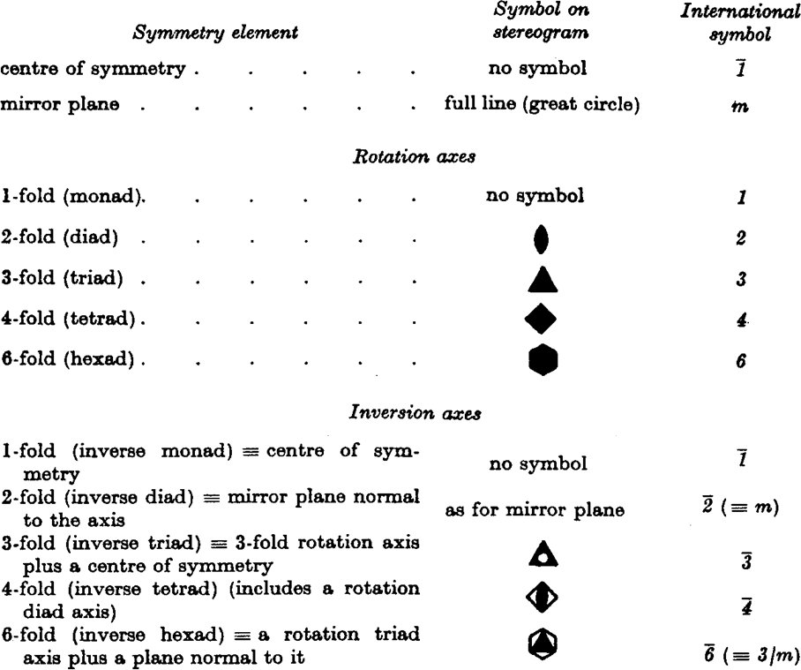
Crystal systems
Symbolism for the symmetry elements of the 32 point groups
The 32 crystal classes (i.e., point groups) are conventionally grouped into seven crystal systems.
The requirements for membership in a given crystal system is that the symmetry of the class should possess a certain minimum characteristic.
[Table from J.F. Nye, Physical Properties of Crystals, (Oxford University Press, Oxford, 1985) p. 280]

Slide 46
We can describe shapes and arrangements of points within shapes in terms of the symmetry exhibited by them.
Cubic
Orthorhombic
120°
In crystal systems, the symmetry of a class of crystals should possess a certain characteristic symmetry (i.e., certain minimum symmetry elements).
Hexagonal
Monoclinic
Tetragonal
Triclinic
Rhombohedral

Slide 47
We describe crystal symmetry relative to specific crystallographic axes and symmetry elements operating on those axes
The order of Hermann-Mauguin symbols in point groups
Crystal System Primary Secondary
Tertiary
Triclinic − −
−
Monoclinic
[010], unique axis b −
[001], unique axis c
−
Orthorhombic
[100] [010]
[001] [100], [010]
[001]
Tetragonal
[1 10], [110]
Trigonal, Rhombohedral Axes
[111]
[1 10], [011], [101]
Trigonal, Hexagonal Axes
[001]
[100], [010], [110]
Hexagonal
[001]
[100], [010], [1 10]
[1 10], [120, [210]
Cubic
[100], [010], [001]
[111], [1 11], [11 1], [1 11]
[1 10], [110], [01 1],
[011], [101], [101]
Table adapted from R. Tilley, Crystals and Crystal Structures, John Wiley & Sons, Hoboken, NJ, 2006, p. 73.
The concept of crystal symmetry is illustrated on the next six viewgraphs.
You should review this and related literature on your own time.

Slide 48
Rotation about the center point.
1
180° rotation moves point “1” to “2” but produces same pattern.
Second 180° rotation moves original point (labeled with a “1”) back to its starting point.
2
2-fold rotation.

Slide 49
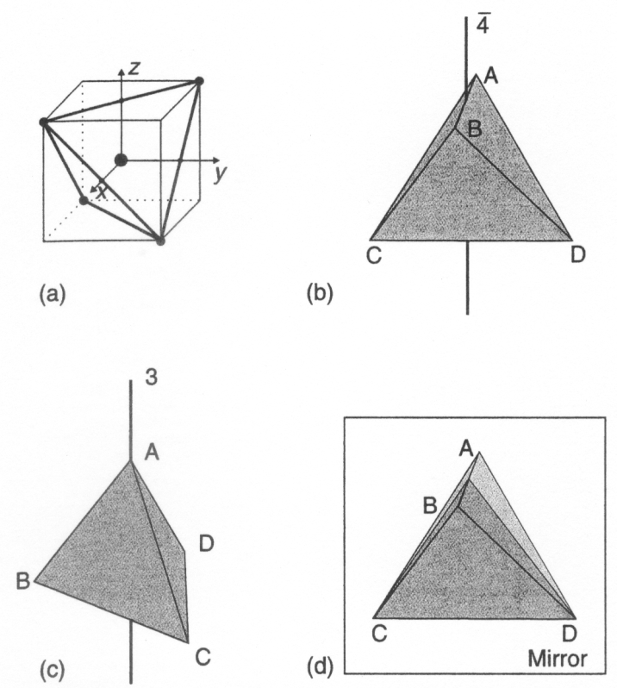
43m
4-fold inversion axes parallel to x,y,z
(aka, <100>)
Tetrahedron inscribed in a cube
3-fold rotation axes parallel to cube diagonals
(aka, <111>)
Mirror plane parallel to face diagonals (aka, <110>)
Symmetry elements in a regular tetrahedron. (a) tetrahedron inscribed in a cube showing three Cartesian axes; (b) 4-fold inversion axes along x [100], y [010] and z [001]; (c) 3-fold rotation axes passing through vertex and center of opposite triangular face (i.e., [111]); (d) mirror planes parallel to [110]. Adapted from Fig. 4.6 in R. Tilley, Crystals and Crystal Structures, John Wiley & Sons, Hoboken, NJ, 2006.

Slide 50
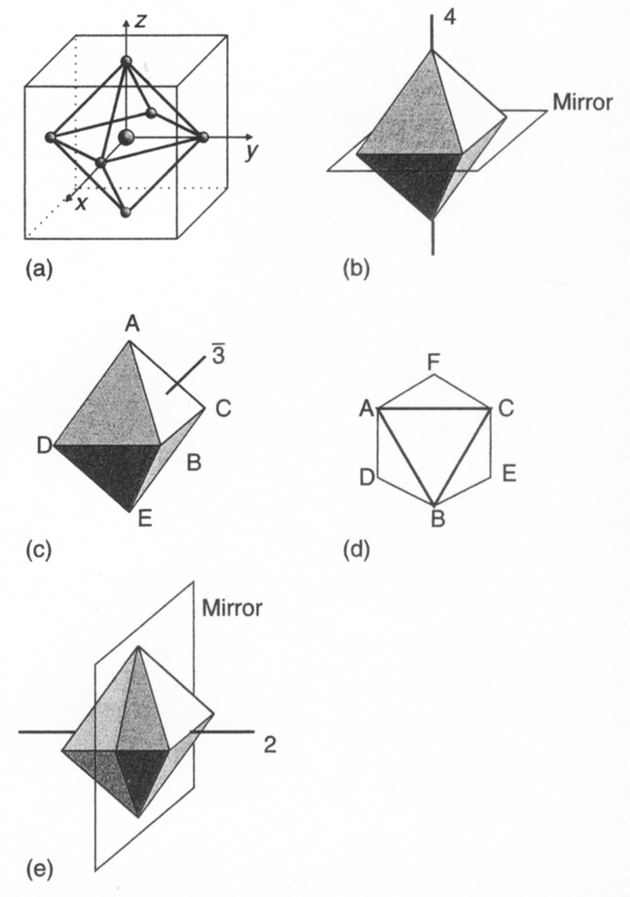
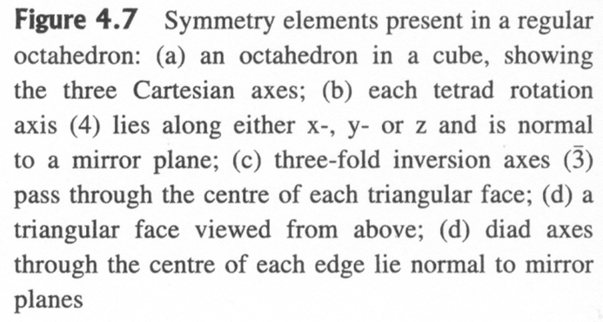
43m
4-fold rotation axes parallel to x,y,z (aka, <100>) with perpendicular mirror plane.
Octahedron inscribed in a cube
3-fold inversion axes parallel to cube diagonals (aka, <111>)
R. Tilley, Crystals and Crystal Structures, John Wiley & Sons, Hoboken, NJ, 2006.
2-fold rotation axes parallel to face diagonals
(aka, <111>) with perpendicular mirror plane.

Slide 51
We describe lattice shapes and arrangements of lattice points in the same way.

Slide 52
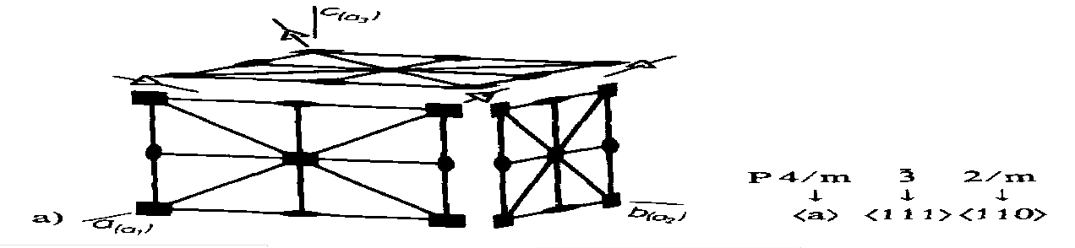
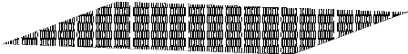
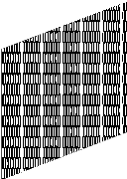

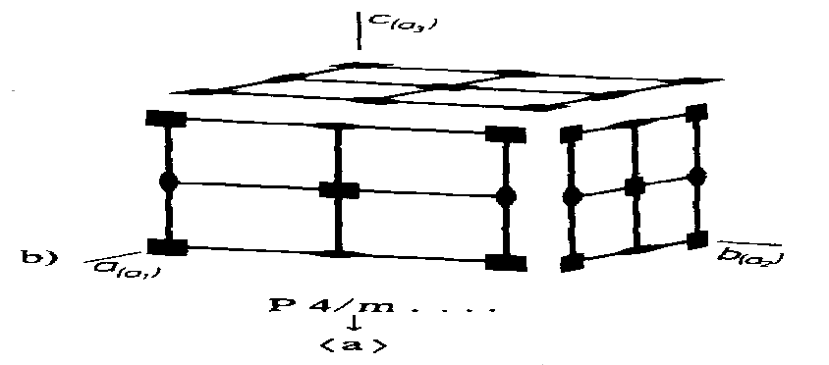
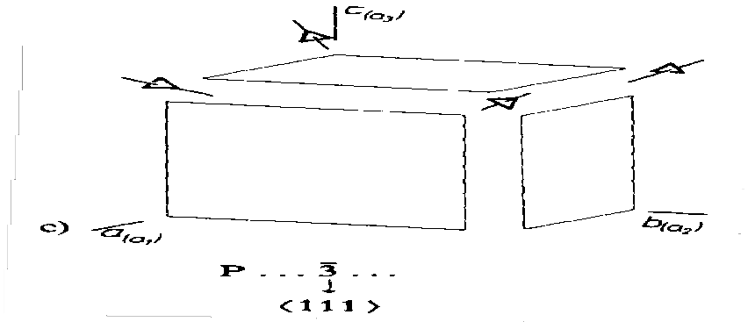
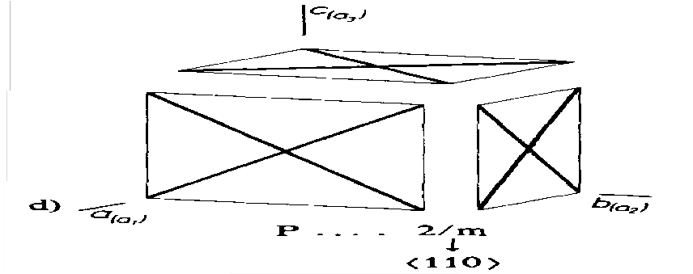
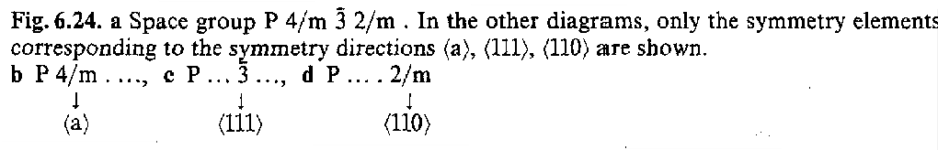
Symmetry of the Cubic P-Lattice
Letter symbol
↑
P 4 m 3 2 m
↓ ↓ ↓
100 111 110
Four 3-fold rotation axes parallel to cube diagonals
(aka, <111>)
Primary
Secondary
Tertiary
Adapted from W. Borchardt-Ott, Crystallography, 2nd Edition, (Springer, Berlin, Germany, 1995) p. 99

Slide 53
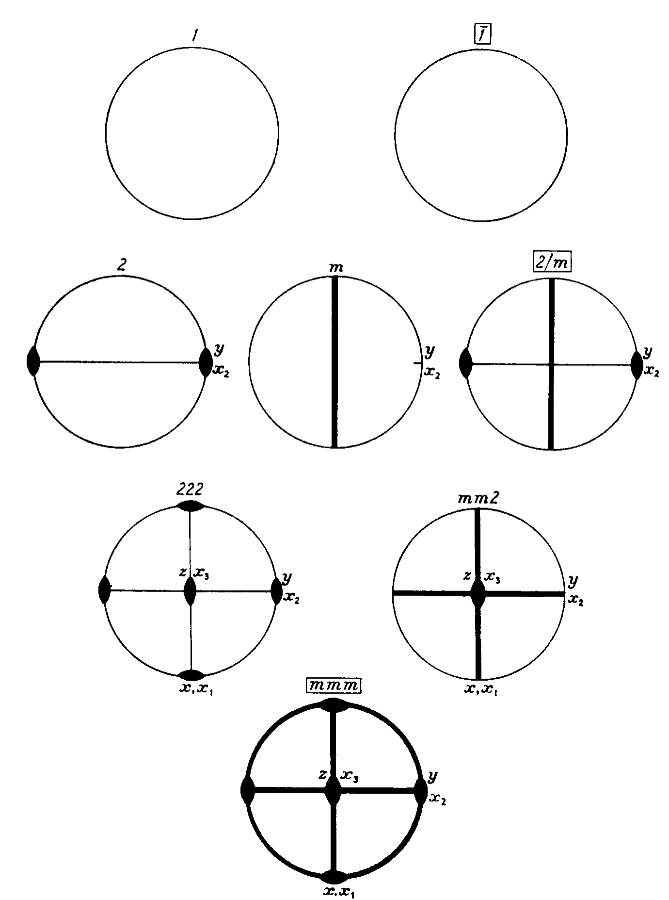
Table 21
Symmetry elements and conventions for the choice of axes in the 32 crystal classes
Symbols of centrosymmetrical classes are enclosed in boxes
There are only 32 crystal classes derived from the 7 crystal systems (i.e., shapes).
Triclinic
Monoclinic
Each has a certain characteristic symmetry.
Orthorhombic
They are presented on stereograms on this viewgraph and the two that follow.
[Nye, p. 284]
Table 21.3

Slide 54
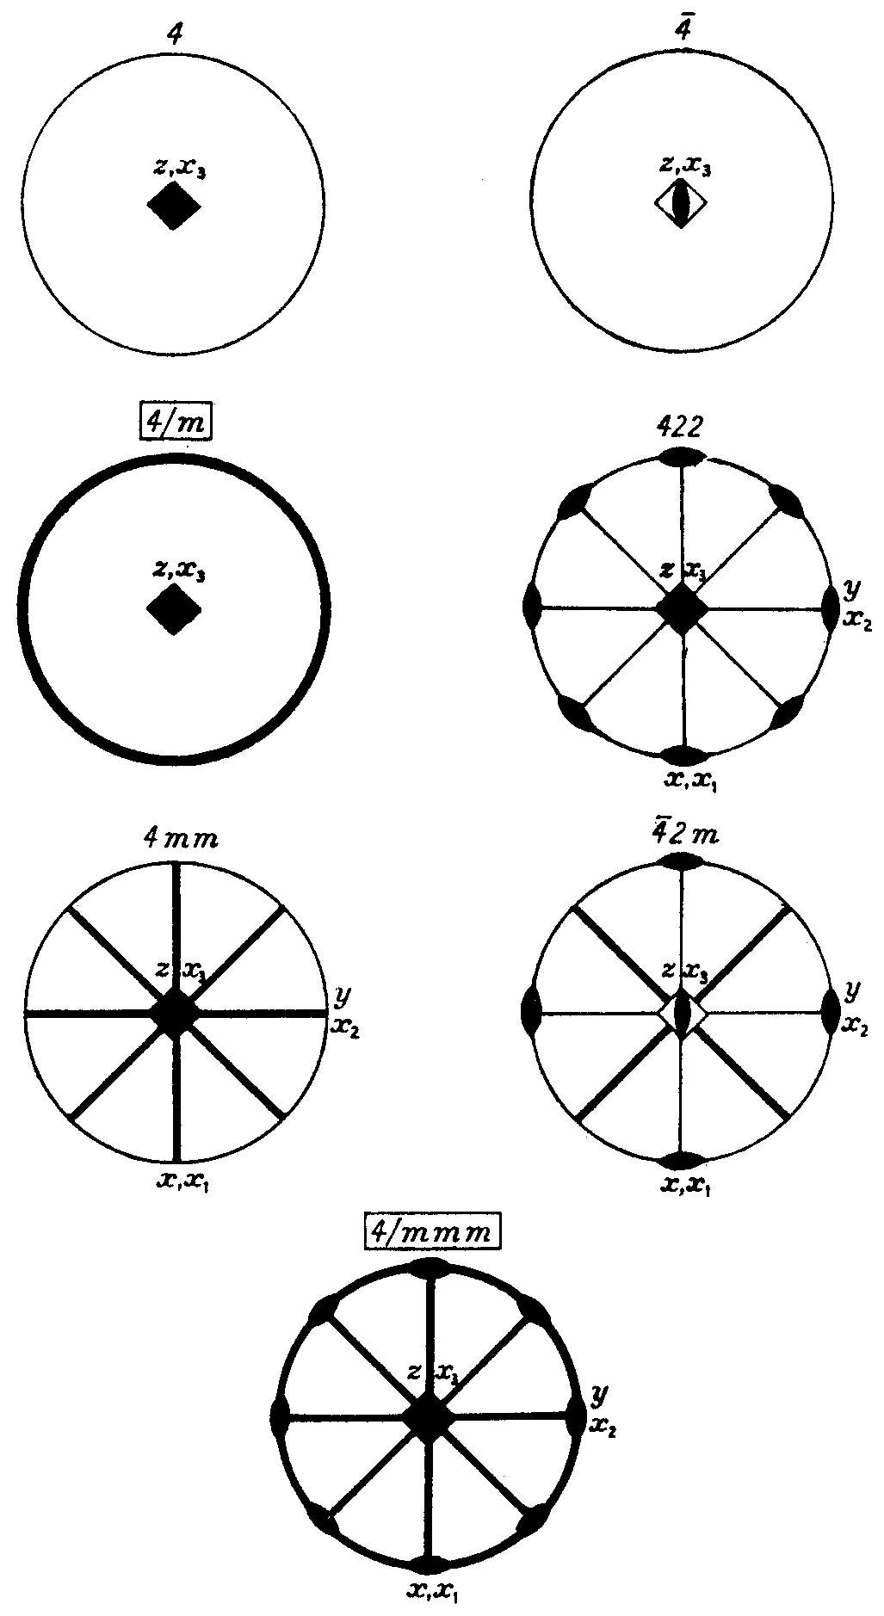
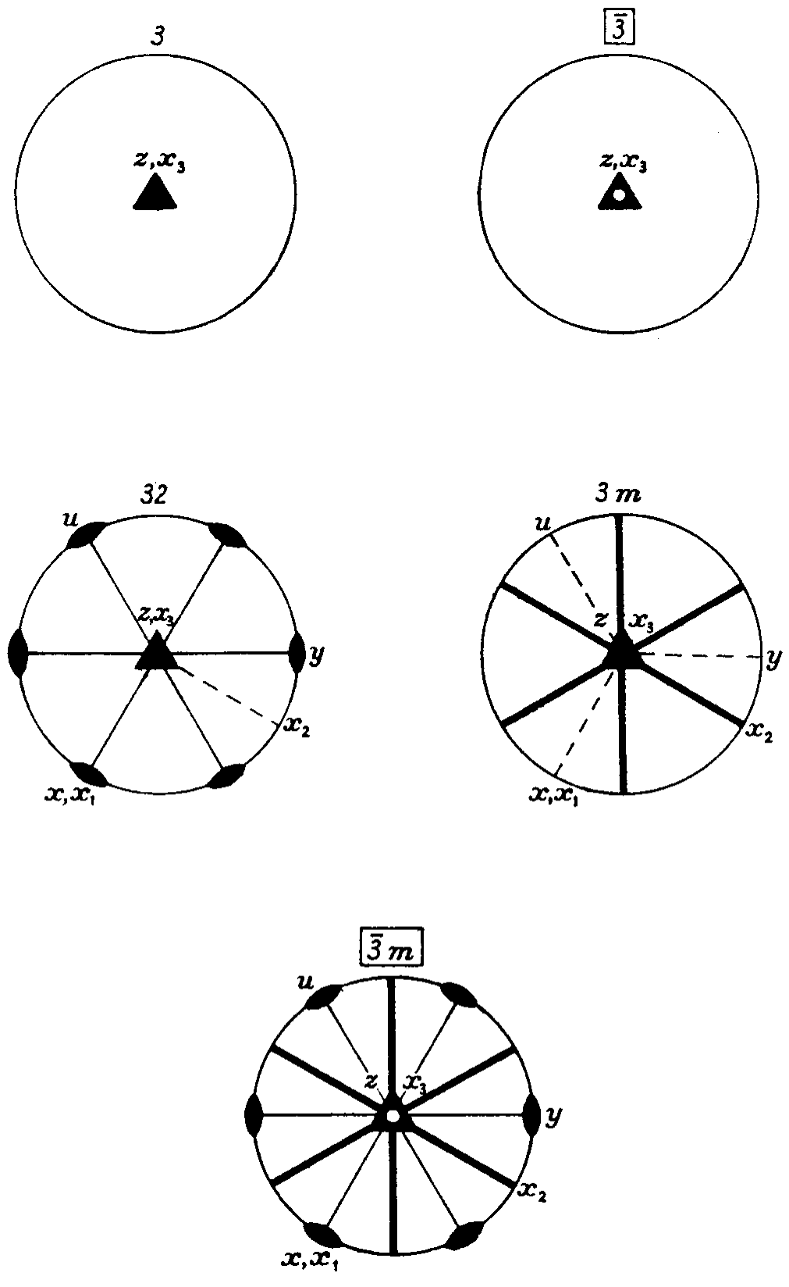
Tetragonal
Trigonal
[Nye, pp. 285-286]
Table 21.2
Table 21.3

Slide 55
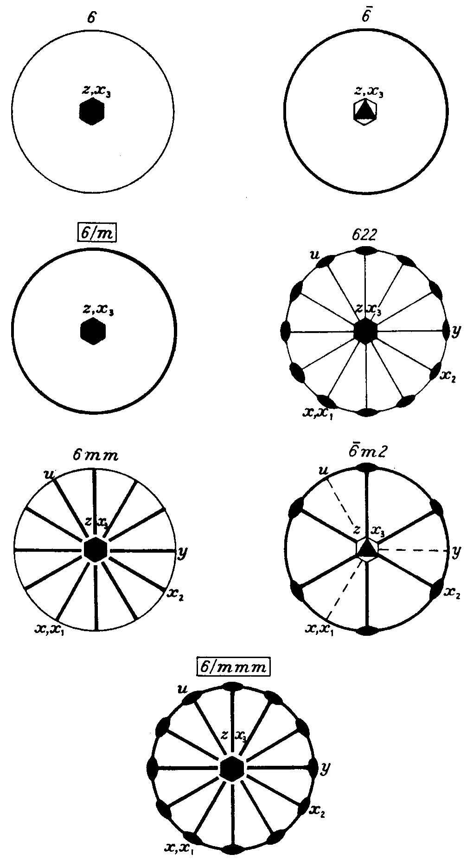
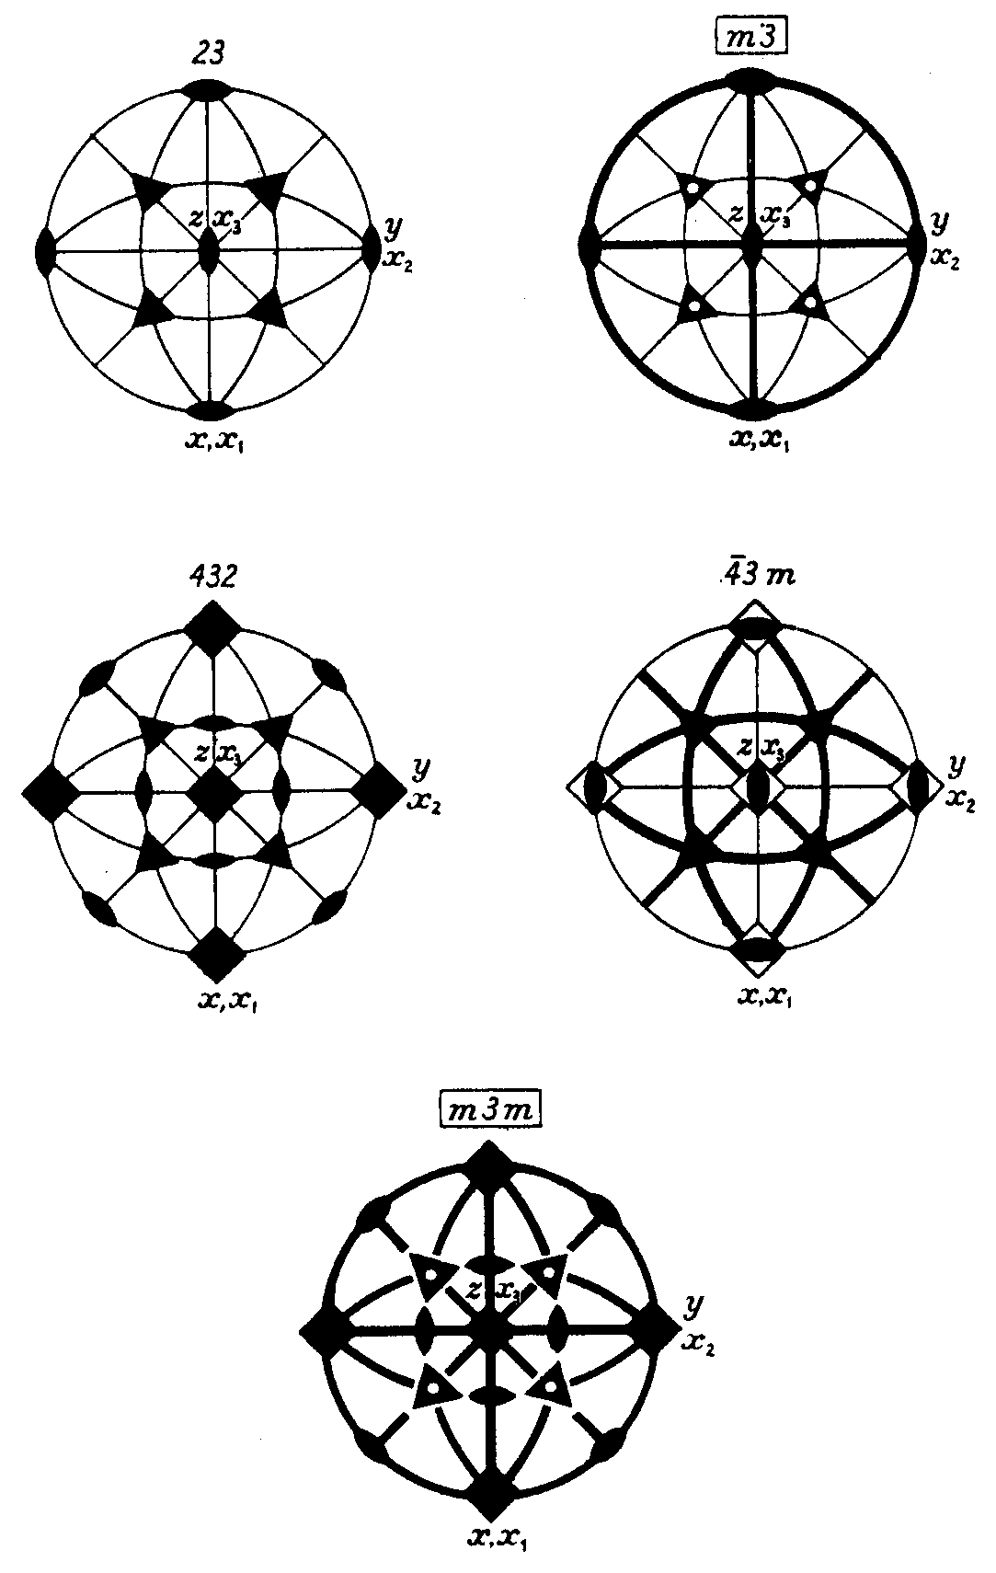
Hexagonal
Cubic
[Nye, pp. 287-288]
Table 21.4
Table 21.5

Slide 56
Influence of Crystal Symmetry on Number of Elastic Constants
Crystal System | Axial Relation- ships | Interaxial Angles | Minimum Symmetry Elements | Number of Elastic Constants
Cubic | a = b = c | α = β = γ = 90° | Four 3-fold rotation or rotoinversion axes parallel to body diagonals | 3
Hexagonal | a = b ≠ c | α = β = 90°; γ = 120° | One 6-fold rotation or rotoinversion axis parallel to z-axis | 5
Tetragonal | a = b ≠ c | α = β = γ = 90° | One 4-fold rotation or rotoinversion axis parallel to z-axis | 6 or 7
Rhombohedral (Trigonal) | a = b = c | α = β = γ ≠ 90° | One 3-fold rotation or rotoinversion axis parallel to z-axis | 5, 6 or 7
Orthorhombic | a ≠ b ≠ c | α = β = γ = 90° | Three 2-fold rotation or rotoinversion axes parallel to x,y,z-axes | 9
Monoclinic | a ≠ b ≠ c | α = γ = 90° ≠ β | One 2-fold rotation or rotoinversion axis parallel to y-axis | 13
Triclinic | a ≠ b ≠ c | α ≠ β ≠ γ ≠ 90° | - None - One 1-fold rotation or rotoinversion axis | 21
Increasing crystal symmetry
Increasing # Elastic const.

Slide 57
Reduction of Elastic Constants with Increasing Symmetry
A clear explanation of the reduction in the number of elastic constants due to crystal symmetry is provided in Chapter 6 of Wagoner and Chenot (pp. 196-207).
Excellent explanations are also provided in Nye (i.e., Ch. 8 and Appendix B) and in Reid (Ch. 3).
You are urged, but not required, to review some of this material.

Slide 58
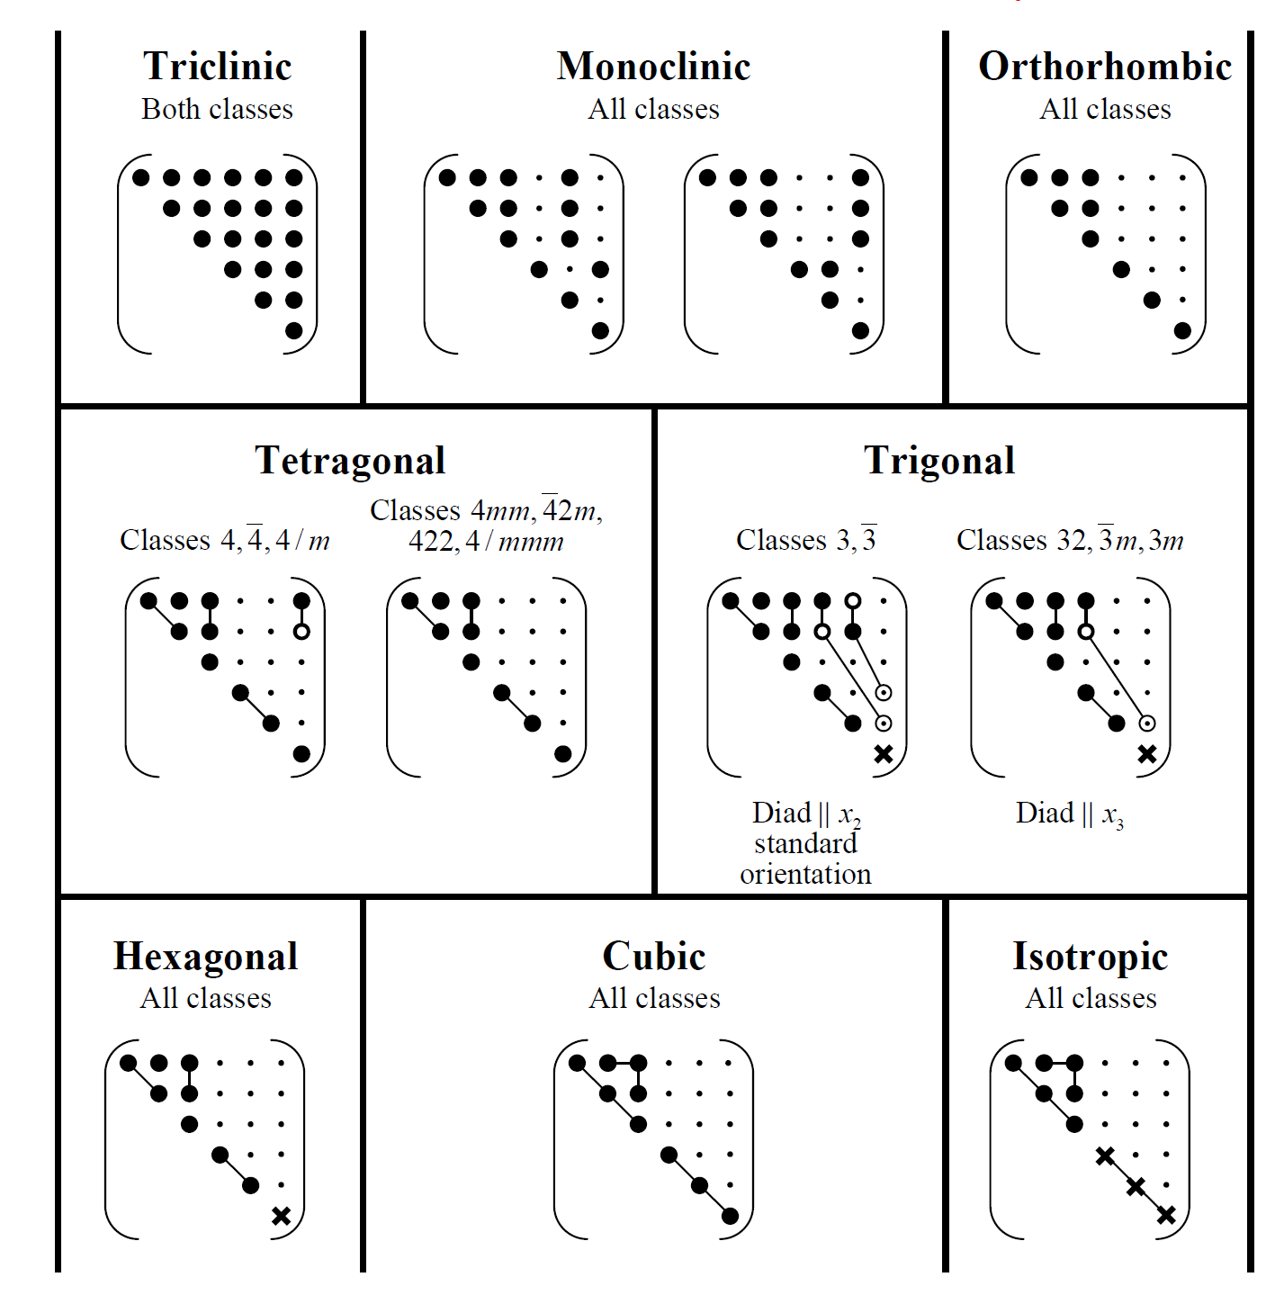
Form of the elastic constant matrices for different symmetries
Zero component (s = 0, c = 0)
Non-zero component (s ≠ 0, c ≠ 0) Equal components
Numerically equal but opposite
◉ = 2 for s;  = /2 for c
=2(s₁₁ – s₂₂) or (c₁₁ – c₂₂)/2
Figure adapted from J.F. Nye, Physical Properties of Crystals, Oxford University Press (1985), p. 140-141.

Slide 59
Cubic Symmetry and Elastic Constants
3
2
1
Application of a stress along the [100] direction evokes a certain elastic response. Stresses applied along the [010] or [001] axes will evoke an equivalent elastic response. Thus:
–
^{C}11 ^{= C}22 ^{= C}33
Similarly, applied shear stresses will evoke equivalent responses along the following axes:
–
^{C}44 ^{= C}55 ^{= C}66^{; C}12 ^{= C}13 ^{= C}23
The number of independent elastic constants for a cubic material is 3.

Slide 60
Isotropy considerations
3
2
1
Cubic materials are not necessarily isotropic.
For these systems, anisotropy is defined by the Zener ratio, A:
(C₁₁ − C₁₂ ) / 2C₄₄
or
2 (S₁₁ − S₁₂ ) / S₄₄
A =
NOTE: Some books (Ex., Hertzberg) present an inverted version of this equation. However, the implications are still the same.
When the Zener ratio = 1, the material is isotropic.

Slide 61
FOR CUBIC SOLIDS
C₁₂ C₁₂ 0 0 0 ⎞
11 12 ⁰ ⁰
⋅ C₁₁ 0 0
⎜ ⋅ ⋅ C 0 ⎟
⎜ ⋅ ⋅ ⋅ ⋅ C₄₄ 0 ⎟
⋅ ⋅ ⋅ ⋅
⎛ ^{C}11
⎜ ⋅
C C
₀ ⎟
⎜
⎜ ⋅
⎟
0 ⎟
⎜ ⋅
₀ ⎟
C
₌ ^{C}11 ^{− C}22
44
2
44
⎜ ⋅
C
⎟
⎝
44 ⎠
S₁₂ S₁₂ 0 0 0 ⎞
⎜ 11 12 ⁰ ⁰ ⎟
⎜ ⋅ ⋅ S₁₁ 0 0 0 ⎟
⎜ ⋅ ⋅ S 0 ⎟
⎜ ⋅ ⋅ ⋅ ⋅ S₄₄ 0 ⎟
⋅ ⋅ ⋅ ⋅
⎛ ^{S}11
⎜ ⋅
S S
₀ ⎟
⎜ ⋅
₀ ⎟
S = 2(S − S
)
44
11
22
44
⎜ ⋅
S
⎟
⎝
44 ⎠
We can assume that most polycrystalline solids are isotropic but not all.

Slide 62
Many parameters are used to describe the elastic properties of materials
_{G =} 1 ₌ 1
E = ¹
ν = − ^{S12}
^{S}44
2 (S₁₁ − S₁₂ )
^{S}11
^{S}11
These expressions are for isotropic solids. They are interrelated
E
2 (1+ν )
G =
See Ch. 8 in Nye, Ch. 13 in Newnham, or Ch. 10 in Gersten for a more thorough explanation.
Wikipedia also provides a nice discussion.

Slide 63
Elastic Moduli in Cubic Materials
We can use the different relations among elastic constants to ascertain elastic moduli in any crystallographic orientation
1 _{= S}
⎞
(
α β + β ²γ ² + α ²γ ² )
− 2 ⎛ S − S − ¹ S
2 2
E
11
⎜
11
12
2
44 ⎟
⎝
⎠
hkl
Where α, β, and γ are the direction cosines between the [hkl] crystal direction and the [100], [010], and [001] directions (i.e., the x,y,z axes).
α = cos(∠[hkl][100]) ; β = cos(∠[hkl][010]) ; γ = cos(∠[hkl][010])

Slide 64
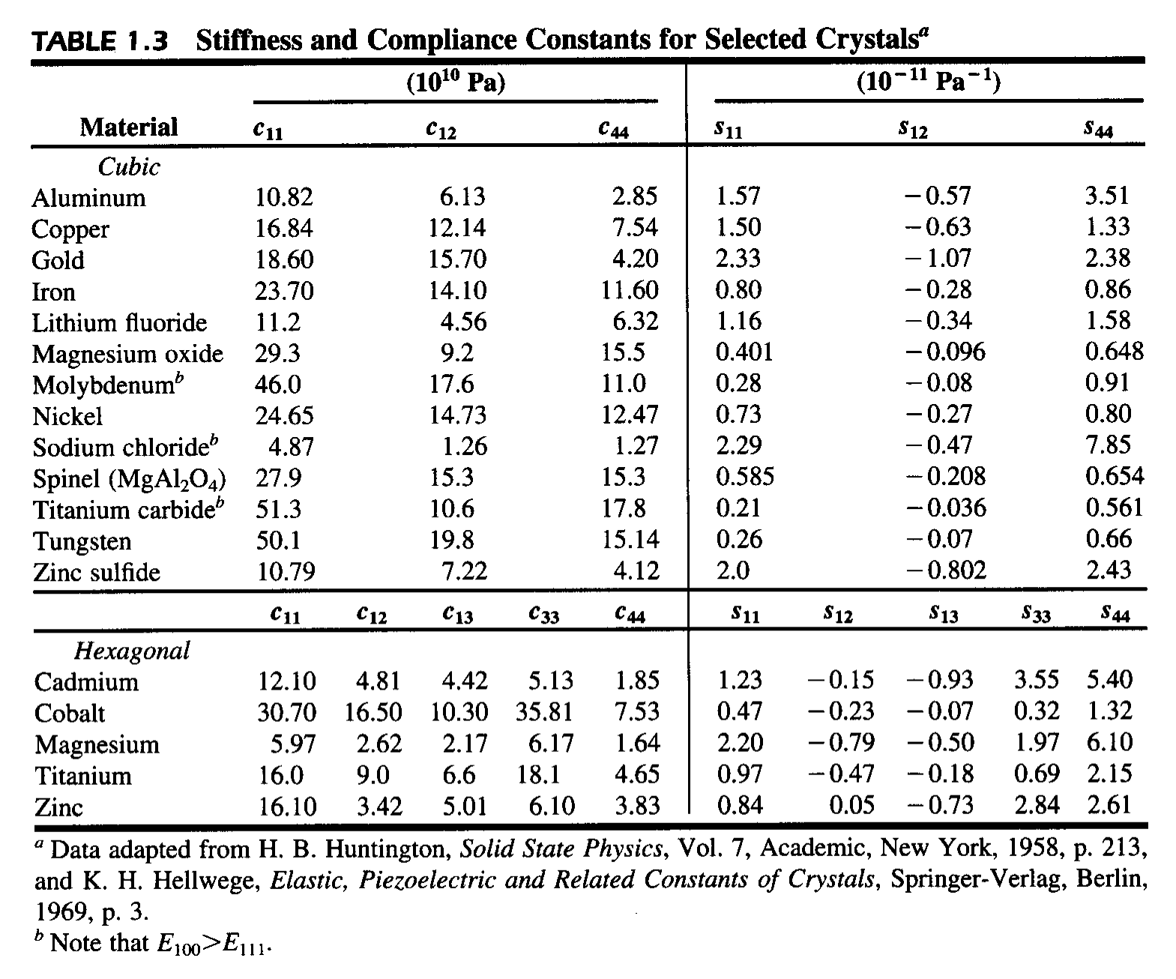
R.W. Hertzberg, Deformation & Fracture Mechanics of Engineering Materials, 4th ed., (John Wiley & Sons, New York, 1996) p. 14.

Slide 65
Elastic properties of polycrystals
In single crystals elastic constants are determined by bonding between atoms. As such, most single crystals are mechanically anisotropic.
In polycrystals, the anisotropic behavior of each grain “averages out” because: (a) grain orientations tend to be random; and (b) the deformation of one grain is dependent on the deformation of its neighbor.
Exceptions occur when the material is textured (i.e., the grains exhibit a preferred orientation).
Page 34 in Hosford lists some possibilities.

Slide 66
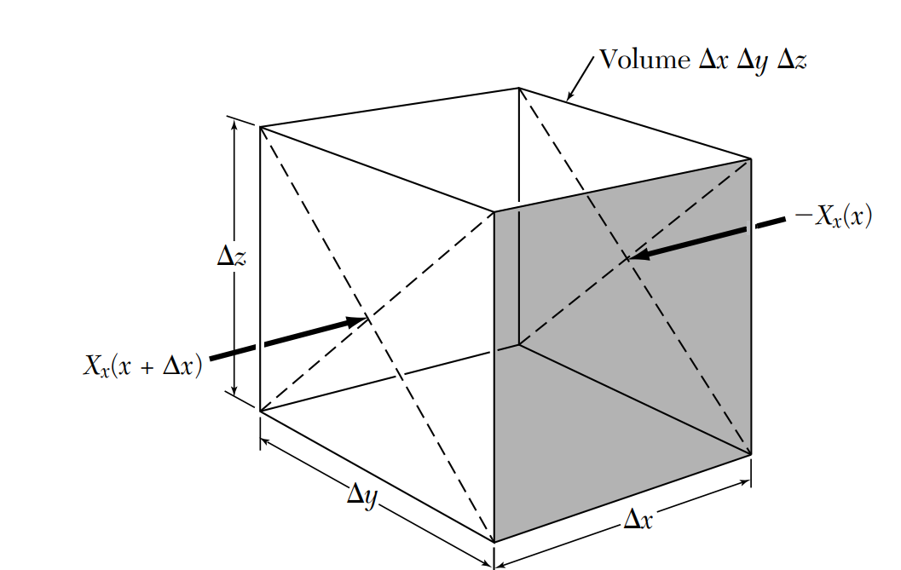
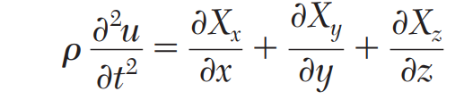
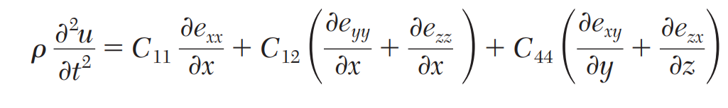
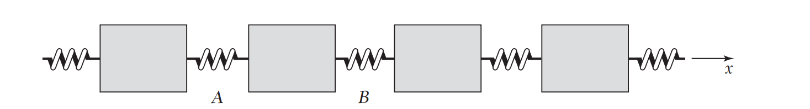
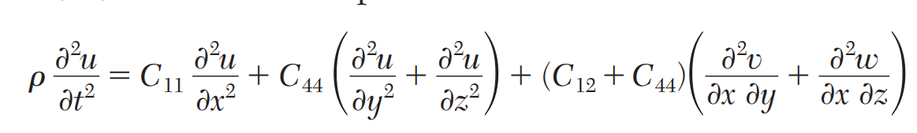
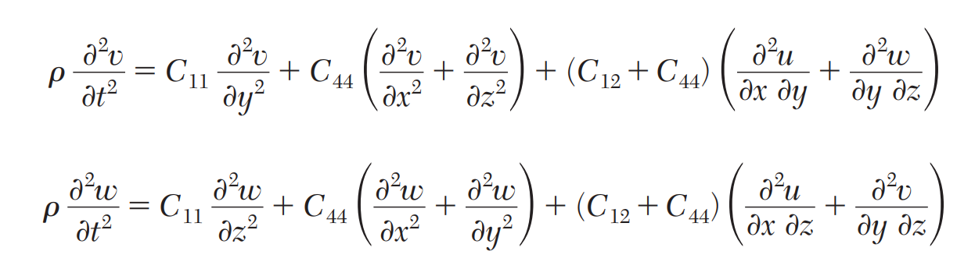
Elastic Waves in Cubic Crystals
Equation of Motion in X direction
Equations of Motion

Slide 67
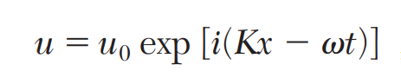
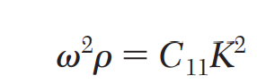


Elastic Waves in Cubic Crystals
Waves in the [100] Direction
One solution is given by a longitudinal wave
the velocity /K of a longitudinal wave in the [100] direction is

Slide 68

Temperature dependence of elastic moduli
Young’s modulus does vary with temperature.
For metals and ceramics there are some general rules of thumb for temperatures lower than half of the melting temperature.
Different rules apply for polymers.

Slide 69

Origin of T dependence
U
Repulsion
r_{o}
r_{T}
1
 |  | U_{t}
r
T₁ > 0 K
T = 0 K
o
Attraction

Slide 70
Young’s modulus also tends to scale with T_{mp} for similar reasons.
E (GPa)
500
Ir
Re
Ru
W
400
300
Mo
Be
Fe
200
Mn Ni Cu
Ta
100
Zn
Cr
Sn Na
Al
Ag _{Au}
Ti
Nb
Zr
_{Pb} Mg
0
0
500 1000 1500 2000 2500 3000 3500
T_{mp} (K)

Slide 71

Influence of alloying
Alloying generally has little influence on the stiffness of materials. This is because the solubility of alloying elements is generally very small (<10%).
207
121
As noted by Roesler et al., the elastic modulus for Al alloys varies by roughly 10% while their strengths can be significantly altered by alloying.
[Roesler, p. 41]
The Cu-Ni system is an exception to the rule. Ni is 100% soluble in Ni.

Slide 72

材料的弹性性质模拟

Slide 73




Stress tensor
Strain tensor
$$\left[\begin{matrix}σ_{xx} & σ_{xy} & σ_{xz} \\ σ_{xy} & σ_{yy} & σ_{yz} \\ σ_{xz} & σ_{yz} & σ_{zz}\end{matrix}\right]$$
$$\left[\begin{matrix}ε_{xx} & ε_{xy} & ε_{xz} \\ ε_{xy} & ε_{yy} & ε_{yz} \\ ε_{xz} & ε_{yz} & ε_{zz}\end{matrix}\right]$$
Stress-Strain relation
$$σ_{ij}=\sum{C_{ijkl}}ε_{kl}$$
Elastic constant

Slide 74



$$x^{′}=\left(1+ε_{xx}\right)\hat{x}+ε_{xy}\hat{y}+ε_{xz}\hat{z} ;$$
$$y^{′}=ε_{yx}\hat{x}+\left(1+ε_{yy}\right)\hat{y}+ε_{yz}\hat{z} ;$$
$$z^{′}=ε_{zx}\hat{x}+ε_{zy}\hat{y}+\left(1+ε_{zz}\right)\hat{z} .$$
$$ε_{αβ}$$
define the deformation; they are dimensionless and have values << 1 if the strain is small
Unstrained
Deformed

Slide 75
模拟流程
确定平衡结构
计算Stress Tensor
构建 Strain Stress relation
0 K Lattice Relaxation
Finite Temperature NPT MD
基于经验势计算
01
02
03
04
05
06
微扰晶胞
确定Strain tensor
重复02-05
求解弹性常数
通常是3个tensile、
3个 Shear
注意Strain tensor 三个Shear 分量
最少需要六次

Slide 76


1. 确定平衡结构
1. 获取平衡结构
0 K - 晶胞优化
有限温度- NPT 分子动力学

Slide 77



2. 微扰晶胞
2. 微扰晶胞
定义一个 deformation gradient 矩阵$F$,
$$F=\left[\begin{matrix}F_{xx} & F_{yx} & F_{zx} \\ F_{xy} & F_{yy} & F_{zy} \\ F_{xz} & F_{yz} & F_{zz}\end{matrix}\right]=\left[\begin{matrix}1 & δ & 0 \\ 0 & 1 & 0 \\ 0 & 0 & 1\end{matrix}\right]$$
将$F$与原始晶胞相乘得到deform以后的新晶胞，
$$\left[\begin{matrix}a_{2x} & b_{2x} & c_{2x} \\ a_{2y} & b_{2y} & c_{2y} \\ a_{2z} & b_{2z} & c_{2z}\end{matrix}\right]=\left[\begin{matrix}F_{xx} & F_{yx} & F_{zx} \\ F_{xy} & F_{yy} & F_{zy} \\ F_{xz} & F_{yz} & F_{zz}\end{matrix}\right]\left[\begin{matrix}a_{1x} & b_{1x} & c_{1x} \\ a_{1y} & b_{1y} & c_{1y} \\ a_{1z} & b_{1z} & c_{1z}\end{matrix}\right]$$
以fcc为例，
$$\left[\begin{matrix}a & aδ & 0 \\ 0 & a & 0 \\ 0 & 0 & a\end{matrix}\right]=\left[\begin{matrix}1 & δ & 0 \\ 0 & 1 & 0 \\ 0 & 0 & 1\end{matrix}\right]\left[\begin{matrix}a & 0 & 0 \\ 0 & a & 0 \\ 0 & 0 & a\end{matrix}\right]$$
注意： 微扰完晶胞需要对原子位置进行优化
0K 结构优化
有限温度 NVT 分子动力学

Slide 78




3. 计算 Stress Tensor
对晶格施加微小应变，计算应变后的总能量 $E(ε)$
计算 Stress Tensor：
Numerical : Finite difference
Analytical : Depends on the energy functional
计算量较大，因为需要对系统进行多次微小扰动，每次扰动都需要重新计 算能量或力，因此计算速度较慢，且数值精度受限于微小扰动的大小。
在有限温度下，材料的能量$E$对体积$V$和晶格变形参数的导数可以得到应力张量的表达式。考虑到体积变形和剪切变形，应力张量的表达为：
$$σ_{αβ}=\frac{1}{V}\frac{∂E}{∂ε_{αβ}}$$
其中， $ε_{αβ}$是应变张量的分量

Slide 79


4. 确定 Strain Tensor
小应变理论中的应变定义在连续介质力学中可以用变形梯度张量$F$表示：
$$ε_{ij}=\frac{1}{2}\left(u_{i,j}+u_{j,i}\right)=\frac{1}{2}\left(F_{ij}+F_{ji}\right)−δ_{ij}$$
只关注形变影响，通过Green-Lagrange strain tensor的推导，我们可以得到，
$$\begin{matrix}E & = & \frac{1}{2}\left(F^{T}F−I\right)\end{matrix}$$
放到小应变假设下，就可以省去二阶以上的高阶项，就有$E≈ε$
从而可以得到Strain Tensor的各个分量，继而得到Stress Tensor

Slide 80

5. Stress - Strain relation
Stiffness张量通过弹性常数$C_{ij}$​将Stress分量与Strain分量关联起来
$$\begin{matrix}\left[\begin{aligned}σ_{xx} \\ σ_{yy} \\ σ_{zz} \\ σ_{yz} \\ σ_{xz} \\ σ_{xy}\end{aligned}\right] & = & \left[\begin{matrix}C_{11} & C_{12} & C_{13} & C_{14} & C_{15} & C_{16} \\ C_{12} & C_{22} & C_{23} & C_{24} & C_{25} & C_{26} \\ C_{13} & C_{23} & C_{33} & C_{34} & C_{35} & C_{36} \\ C_{14} & C_{24} & C_{34} & C_{44} & C_{45} & C_{46} \\ C_{15} & C_{25} & C_{35} & C_{45} & C_{55} & C_{56} \\ C_{16} & C_{26} & C_{36} & C_{46} & C_{56} & C_{66}\end{matrix}\right]\left[\begin{aligned}ε_{xx} \\ ε_{yy} \\ ε_{zz} \\ 2ε_{yz} \\ 2ε_{xz} \\ 2ε_{xy}\end{aligned}\right]\end{matrix}$$
Strain分量 "ε" 和Stress分量 "σ" 由上述表达式通过一组方程联系起来,这些方程中的未知数是弹性常数$C_{ij}$。在下一步中,我们将收集更多这样的方程,直到我们拥有足够多的方程组来找到所有的$C_{ij}$。

Slide 81

6. 求解弹性常数
使用彼此独立的deformation，直到完成6种deformation。任何6种deformation的组合都是可以的，只要它们是独立的
$$F_{1}=\left[\begin{aligned}&1+δ &&0 &&0 \\ &0 &&1 &&0 \\ &0 &&0 &&1\end{aligned}\right]{ F}_{2}=\left[\begin{aligned}&1 &&0 &&0 \\ &0 &&1+δ &&0 \\ &0 &&0 &&1\end{aligned}\right]{ F}_{3}=\left[\begin{aligned}&1 &&0 &&0 \\ &0 &&1 &&0 \\ &0 &&0 &&1+δ\end{aligned}\right]$$
$$\left.F_{4}=\left[\begin{matrix}1 & δ & 0 \\ 0 & 1 & 0 \\ 0 & 0 & 1\end{matrix}\right.\right]{ F}_{5}=\left[\begin{matrix}1 & 0 & δ \\ 0 & 1 & 0 \\ 0 & 0 & 1\end{matrix}\right]{ F}_{6}=\left[\begin{matrix}1 & 0 & 0 \\ 0 & 1 & δ \\ 0 & 0 & 1\end{matrix}\right]$$
$F_{1}$- $F_{3}$ 代表 tensile deformations， $F_{4}$- $F_{6}$ 代表 shear deformation.

Slide 82


6. 求解弹性常数
为这6种deformation各自写出Stress-Strain relation，并将它们以矩阵形式表示。
$$\left.\left[\begin{matrix}σ_{11} & σ_{12} & σ_{13} & σ_{14} & σ_{15} & σ_{16} \\ σ_{21} & σ_{22} & σ_{23} & σ_{24} & σ_{25} & σ_{26} \\ σ_{31} & σ_{32} & σ_{33} & σ_{34} & σ_{35} & σ_{36} \\ σ_{41} & σ_{42} & σ_{43} & σ_{44} & σ_{45} & σ_{46} \\ σ_{51} & σ_{52} & σ_{53} & σ_{54} & σ_{55} & σ_{56} \\ σ_{61} & σ_{62} & σ_{63} & σ_{64} & σ_{65} & σ_{66}\end{matrix}\right.\right]=\left[\begin{matrix}C_{11} & C_{12} & C_{13} & C_{14} & C_{15} & C_{16} \\ C_{12} & C_{22} & C_{23} & C_{24} & C_{25} & C_{26} \\ C_{13} & C_{23} & C_{33} & C_{34} & C_{35} & C_{36} \\ C_{14} & C_{24} & C_{34} & C_{44} & C_{45} & C_{46} \\ C_{15} & C_{25} & C_{35} & C_{45} & C_{55} & C_{56} \\ C_{16} & C_{26} & C_{36} & C_{46} & C_{56} & C_{66}\end{matrix}\right]\left[\begin{matrix}ε_{11} & ε_{12} & ε_{13} & ε_{14} & ε_{15} & ε_{16} \\ ε_{21} & ε_{22} & ε_{23} & ε_{24} & ε_{25} & ε_{26} \\ ε_{31} & ε_{32} & ε_{33} & ε_{34} & ε_{35} & ε_{36} \\ ε_{41} & 2ε_{42} & 2ε_{43} & 2ε_{44} & 2ε_{45} & 2ε_{46} \\ 2ε_{51} & 2ε_{52} & 2ε_{53} & 2ε_{54} & 2ε_{55} & 2ε_{56} \\ 2ε_{61} & 2ε_{62} & 2ε_{63} & 2ε_{64} & 2ε_{65} & 2ε_{66}\end{matrix}\right]$$
在这个方程中要特别注意指标。在stress tensor 和 strain tensor $σ_{ij}$ 或${ \text{ε}}_{ij}$中，这里ij作为index的含义，与我们至之前使用的ij含义不同。列指标 j 指的是Deformation的编号（第一次Deformation，第二次Deformation,...），而行指标 i 指的是在 Voigt表示法中的位置，如$σ_{24}$​是第四次变形的$σ_{yy}$分量。

Slide 83


6. 求解弹性常数
如果使用之前推荐的Deformation模式.则我们得到上式右边的矩阵$E$,
$$\left.E=\left[\begin{matrix}δ_{1}+\frac{δ_{1}^{2}}{2} & 0 & 0 & 0 & 0 & 0 \\ 0 & δ_{1}+\frac{δ_{1}^{2}}{2} & 0 & \frac{δ_{2}^{2}}{2} & 0 & 0 \\ 0 & 0 & δ_{1}+\frac{δ_{1}^{2}}{2} & 0 & \frac{δ_{2}^{2}}{2} & \frac{δ_{2}^{2}}{2} \\ 0 & 0 & 0 & 0 & 0 & δ_{2} \\ 0 & 0 & 0 & 0 & δ_{2} & 0 \\ 0 & 0 & 0 & δ_{2} & 0 & 0\end{matrix}\right.\right]$$
这时我们只需要求解矩阵$E$的逆。在上式左右两边同时乘以$E^{−1}$，我们就可以得到Stiffness tensor:
$$ΣE^{−1}=C$$

